Slide 1
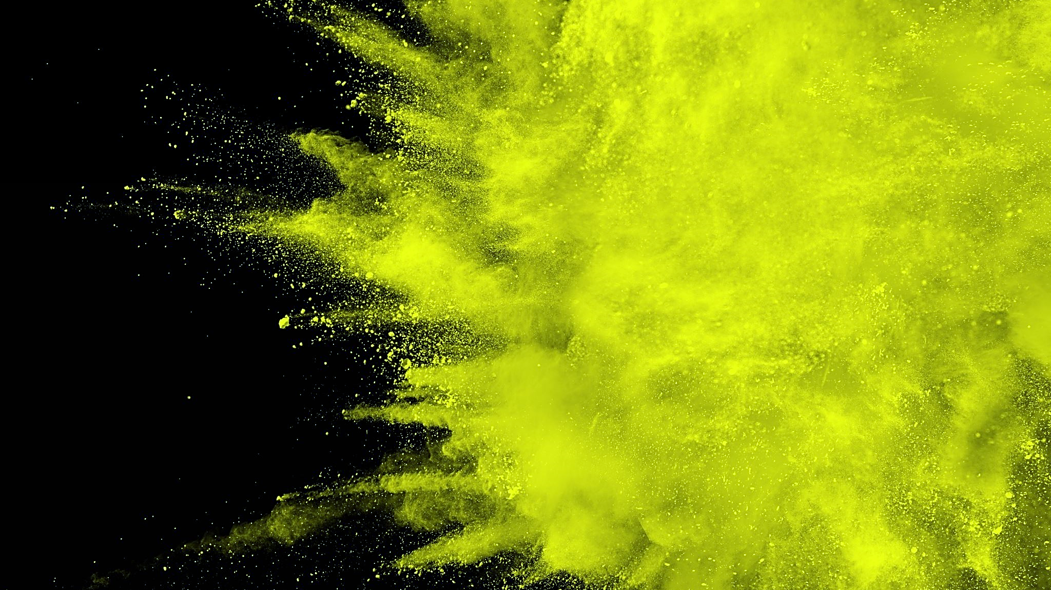
COLOUR COSMETICS
KYRA KROLL
Notes:
Hello everyone, my name is Kyra Kroll, and I will be sharing my research presentation on the colour cosmetics industry with you.
*All graphs in this presentation were made in excel*

Slide 2
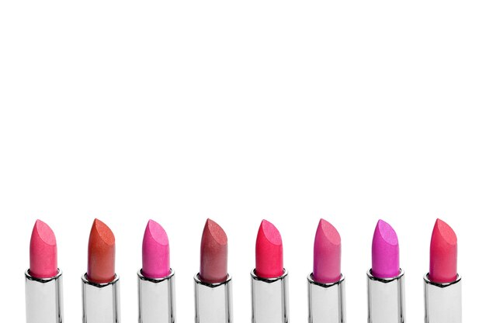
IDENTIFYING OPPORTUNITIES and implications IN THE COLOUR COSMETICS INDUSTRY: North American region
1. MARKET TREND: ENTIRE COLOUR COSMETICS INDUSTRY
2. MARKET TREND: INDIVIDUAL PRODUCT CATEGORIES
3. NATIONAL BRANDS: WHO IS LEADING THIS INDUSTRY?
4. ECONOMIC OVERVIEW
5. CONCLUSION
Notes:
For my research, I was looking to identify opportunities and implications in the colour cosmetics industry for the North American region. To begin my presentation, I will cover market trends for the whole colour cosmetics industry. I will share market trends for individual product categories to follow this data. I will then identify which brands are leading the industry. Once the top national brands are revealed, I will then talk about the economic overview in the industry and then wrap up the presentation with a conclusion.

Slide 3
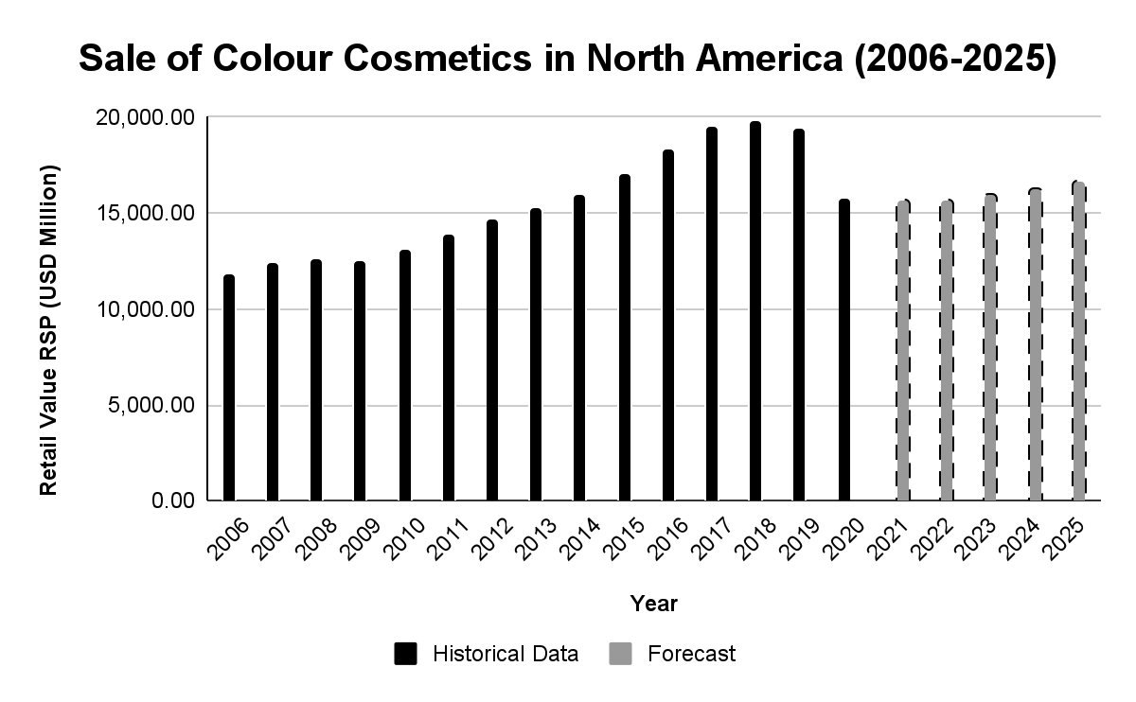
FORECASTED MEASUREMENTS:
2021: $15,628,000
2022: 15, 663,000
2023: $15,907,100
2024: $16,279,000
2025: $16,669,300
PRE-PANDEMIC LEVEL (2019): $19,372,600
DATA FOUND ON PASSPORT
Notes:
This graph represents sales of colour cosmetics in North America from 2006 to 2025 (sales are measured in USD million). The pre-pandemic level in 2019 was set at $19,372,600. In 2020, you can see there was a drastic downturn in sales at $15,781. The forecast anticipates a slight incline in sales: $15,628,000 in 2021; $15,663,000 in 2022; $15,907,100 in 2023; $16,279,000 in 2024; and $16,669,300 in 2025. While there is a slight upward trend, sales in 2025 will still be significantly lower than at the pre-pandemic level. Brands in this industry need to develop a strategy to expedite the growth in sales for the upcoming years if they want to get back to where they were before the pandemic hit.

Slide 4
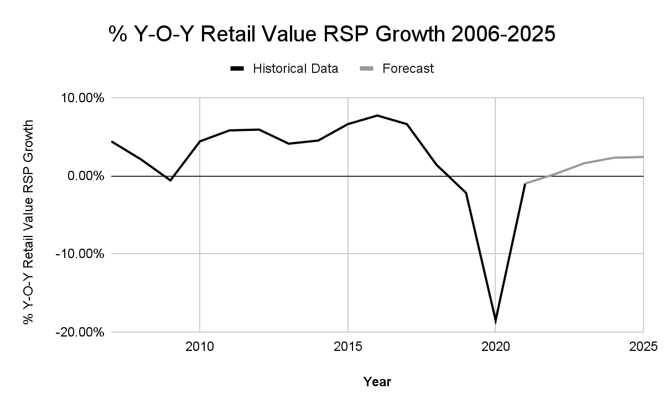
2016: PEAK GROWTH AT 7.7%
2020: -18.5% GROWTH
FORECAST: POSITIVE GROWTH (UP TO 2.4% IN 2025)
DATA FOUND ON PASSPORT
Notes:
Sales are not the only way that performance in this industry is measured. We can also look at the year-over-year growth. There were similar trends in year-over-year growth from 2006 to 2025. Peak growth was in 2016 at 7.7% but started to fall leading up to the 2020 year. In 2020, there was a -18.5% growth; brands in the colour cosmetics industry need to ask themselves what made 2016 so successful and why has subsequent years been unable to match or exceed that growth? According to the forecast, year-over-year growth will be moving positively, up to 2.4% in 2025.

Slide 5
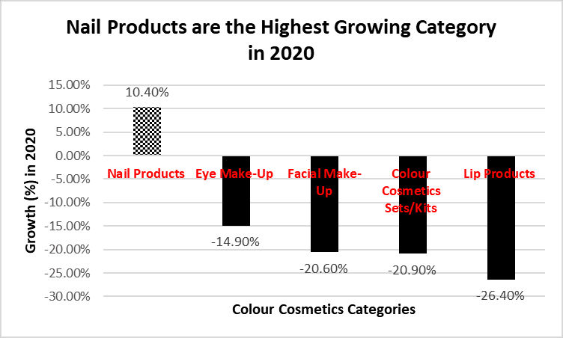
DATA FOUND ON PASSPORT
Notes:
This graph shows the trajectory of growth for each colour cosmetics category in 2020. It is observed that nail products are the highest growing category (10.40%), followed by eye-makeup (-14.90%), facial make-up (-20.60%), colour cosmetics sets/kits (-20.90%), and lastly, lip products (-26.40%). It is important to note that nail products are the only category that has grown positively. Given the growth opportunities of nails cosmetics, brands in this industry should consider adding this category to their product line, and if it already is offered by the company, they should continue to invest in this category.

Slide 6
DATA FOUND ON STATISTA
Notes:
This graph displays category sales in USD billion in 2020, revealing that eye cosmetics are the leading category with 1.96 billion USD in sales. Facial cosmetics is a close second, with 1.9 billion USD in sales, followed by nail cosmetics with 1.5 billion USD sales, and lip cosmetics in last place with 0.81 billion USD in sales. So far, we have learned that nail cosmetics had the most growth in 2020, while eye cosmetics has shown the greatest number of sales. These two categories should be the focus in the upcoming years and display the most potential for success in this industry.

Slide 7
COMPANY SHARES OF COLOUR COSMETICS: % SHARE NATIONAL BRAND OWNERS
Estée Lauder Cos Inc
FEATURING THE TOP FIVE BRANDS IN THE MARKET
DATA FOUND ON PASSPORT
Notes:
I identified the top five national brands in the colour cosmetics industry based on their percent market share. The order of national brands based on their market shares is as follows:
-L'Oréal Groupe 26.3%
-Estée Lauder Cos Inc 19.1%
-Coty Inc 8.2%
-LVMH Moët Hennessy Louis Vuitton SA 7.9%
-Shiseido Co Ltd 4.2%
The “other” category consists of brands with a 3.8% or less market share. Since this category includes 15+ brands with little market significance, I grouped them together. L'Oréal Groupe almost has as much market share as 15+ brands combined, which says a lot about this brand’s power in the industry. Some recognizable brands in the “other” category include Revlon Inc. (3.8% market share), Mary Kay Inc. (3.4% market share), Anastasia Beverly Hills Inc. (1.7% market share), and Kylie Jenner Inc. (1.2% market share).

Slide 8
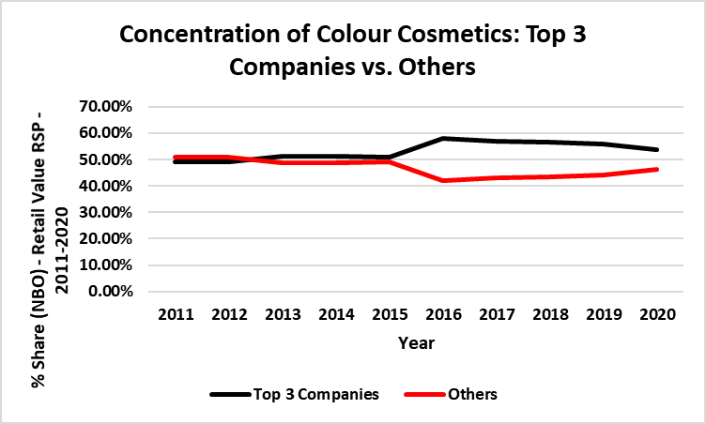
DATA FOUND ON PASSPORT
Notes:
This graph shows the concentration in the colour cosmetics industry between the top 3 national brand owners and the rest of the brands in the market. From 2011 to around 2013, the market was not very concentrated; smaller brands had more market share than more prominent brands. This trend began to change as we approached 2016 when the top 3 companies began to take over the market. However, as we approach 2020, concentration is slowly decreasing. Smaller brands should capitalize on this decrease in concentration and find ways to gain relevance in the industry.

Slide 9
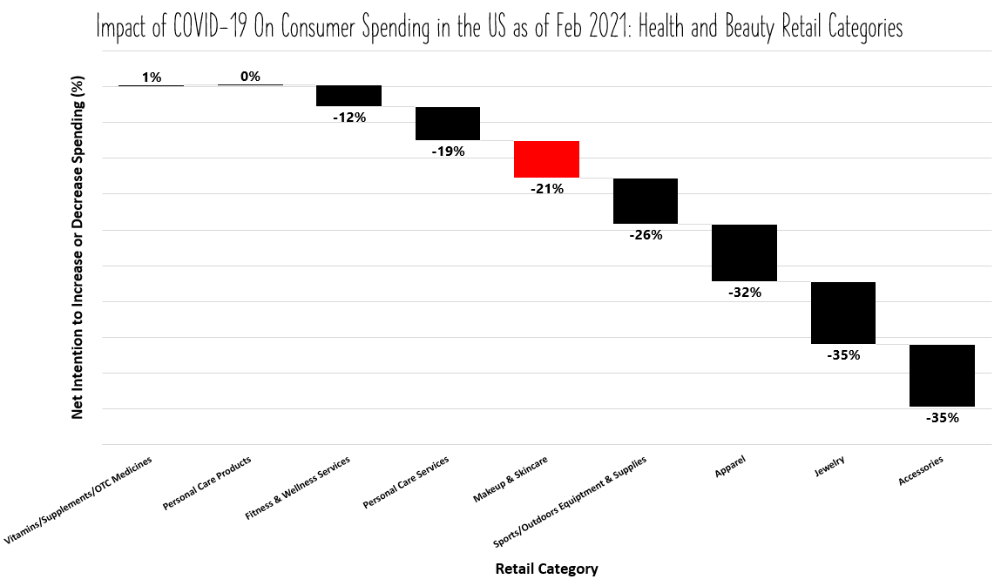
MAKEUP & SKINCARE
DATA FOUND ON STATISTA
Notes:
This visual shows the change in consumer spending in the US as of February 2021 for health and beauty retail categories. The shift in consumer spending is measured by net intention to increase or decrease spending in percentages. The only retail categories that doesn’t show a decrease in spending are personal care products (which have remained stagnant) and vitamins/supplements/OTC medicines, with an increase in intention to spend by 1%. Consumers have less intention to spend money on makeup and skincare products, by -21%. Given that consumers plan to spend money on vitamins/supplements/OTC, individuals in the colour cosmetics industry should consider implementing vitamin-rich ingredients into their cosmetics. For example, vitamin A helps clear acne and psoriasis, reverse photoaging, and enhance skin cell turnover. The colour cosmetics industry can benefit from the success of other retail categories.

Slide 10
CONSUMER PRICE INDEX
FORECAST: 2022-2025
COUNTRY | 2017 | 2018 | 2019 | 2020 | 2021 | 2022 | 2023 | 2024 | 2025
US | 136.3 | 139.6 | 142.2 | 143.9 | 150.7 | 157.2 | 160.2 | 163.7 | 167.3
CANADA | 130.4 | 133.4 | 136 | 137 | 141.4 | 145.3 | 147.9 | 150.9 | 153.8
MEXICO | 184.1 | 193.1 | 200.2 | 207 | 218.6 | 228.6 | 237.3 | 246.1 | 255.9
DATA FOUND ON MINTEL
Notes:
This table shows consumer price indexes from 2017 to 2025 for the US, Canada, and Mexico. The consumer price index has grown in each country year by year. The US started with a consumer price index of 136.3 in 2017 and will end at 167.3 in 2025. The consumer price index starts at 130.4 in Canada and ends at 153.8 in 2025. In Mexico, the consumer price index begins with 184.1 in 2017 and finishes at 255.9 in 2025. The consumer price indexes from 2022 to 2025 are forecasted measures. An increase in the consumer price index means that products and services are getting pricier, forcing consumers to spend more money. An increase in prices, coupled with additional financial struggles caused by the pandemic, could impact how much consumers plan on spending on makeup.

Slide 11
CONCLUSION
Because of the lockdown phase of the pandemic and mask requirements, the need to wear makeup has gone down. What makes this industry interesting is the range and the number of product categories that exist that could help brands retain some success during challenging times.
Product categories that have shown the most potential and will most likely dominate the market in the future based on growth and sales are eye and nail cosmetics.
In the future, we might see brands considering promotional discounts, coupons, or incentives (such as health benefits) to convince consumers to spend extra money on colour cosmetic products.
Notes:
From the data that I collected, I was able to draw on three conclusions that relate to opportunities and implications in the colour cosmetics industry:
Because of the lockdown phase of the pandemic and mask requirements, the need to wear makeup has gone down. The drastic decline in retail value and year-over-year growth in the colour cosmetics industry in 2020 is explained by the impacts of the pandemic. What makes this industry interesting is the range and the number of product categories that exist that could help brands retain some success during challenging times.
Product categories that have shown the most potential and will most likely dominate the market in the future based on growth and sales are eye and nail cosmetics. The mask requirements do not impact the exposure of eyes and nails- consumers may still need to do their eye makeup and paint their nails when they go out in public.
Price increases could be a factor that will draw consumers away from using their discretionary income on makeup; the COVID-19 pandemic has created a negative shift in consumer spending in this industry. In the future, we might see brands considering promotional discounts, coupons, or incentives (such as health benefits) to convince consumers to spend extra money on colour cosmetic products.
To extend on creating health benefits as an incentive, we should expect to see makeup with more vitamin and mineral-rich formulas, and we should expect to see more natural and less intensive makeup since the need for colour cosmetics has declined.

