Slide 1
AD PROJECT
BY
TEAM 10
Yoselyn Porcayo, Anita Safari, Kyra Kroll, Joshua Muller

Slide 2
Business Case
Creamy Cakes is starting a new local business in your locality for Cheesecakes, Muffins, Cookies and Pies.
Creamy Cakes has a website which can be used to purchase products directly. They can be picked up from store by consumer or can be delivered to homes within 5 miles of the location.
As this is a new local business, Creamy Cakes would like to reach max consumers within the geographic area where it is located and motivate them to buy instore or by delivery.

Slide 3
PART 1: SEM PPC Campaign
The firm is planning to start a SEM PPC campaign through Google Ads to improve traffic to website by 15%.
You are the marketing manager responsible for the design and implementation of this ad campaign.
Design a PPC Campaign.

Slide 4
Provide Details about the Ad campaign below:
Type of Campaign: SEM PPC w/ Google Ads
Goal: improve traffic to website by 15%
Targeting: young adults, 25-34 years old, within a 5 mile radius

Slide 5
Adgroup/Keywords
How many Adgroups will you create? Name Each?
  4 Ad Groups (Cheesecake, Pies, Cookies, Muffins)

Slide 6
Adgroup/Keywords - Cheesecakes
What are the selected Keywords?
  Pastry
  Cheesecakes
  Desserts
  Birthday
Give Rationale as to why these keywords have been selected?
  Pastry, Cheesecakes and Desserts all could be used to describe Creamy Cakes
  Birthday was used because there are some people that would prefer cheesecakes as their birthday cakes than the typical birthday cake. (Typically used for small celebrations)

Slide 7
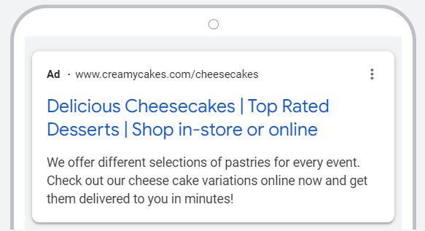

Slide 8
Adgroup/Keywords - Pies
When searching “Pies” on Google’s search engine, people also ask: what are the top 10 favorite pies? What are the top 5 most popular pies? What are the 5 types of pies? What are 8 different kinds of pie?
When searching “Pies” on Google’s search engine, related searches are: pies flavors, types of holiday pies, different types of berry pies, list of official state pies
Google Ads keyword suggestions for “Pies”: Pies, pies, aussie pies, elijah pies, gryfon, greyhound pies
When searching “Pies” on Google’s search engine, common keywords in the results are: Best pie recipes, perfect pie recipes, pie recipes, our best thanksgiving pies
Google Trends: Doodle pies, Hubig’s pies, house of pies katy, hubig pies new orleans, house of pies cypress, pies on nine south, pico pies, raisin creme pies, homemade oatmeal cream pies, hubig pies, nofo pot pies, poorhouse pies, gorilla pies, rad pies, noble pies, poolside pies, pies on post
Rationale: These keywords show a % increase in searches in Google Trends, are common keywords in the Google Search Engine results when searching “Pies”, are related questions and searches when searching “Pies” in the Google Search Engine, and are suggested by Google Ads

Slide 9
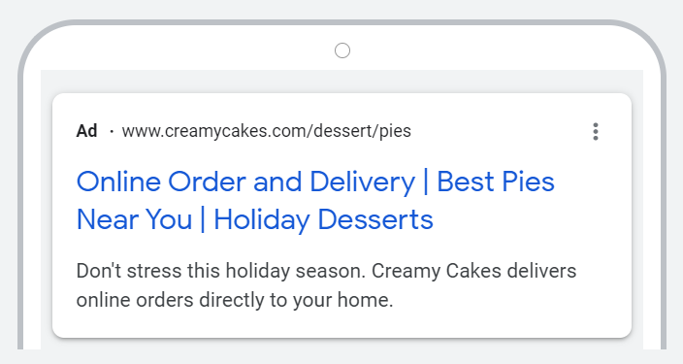

Slide 10
Adgroup/Keywords - Cookies
What are the selected Keywords for each AdGroup?
  Christmas cookies
  Chocolate chip cookies
  Oatmeal cookies
  Peanut butter cookies
  Sugar cookies
Give Rationale as to why these keywords have been selected?
  They are all descriptions of various cookie flavors.

Slide 11
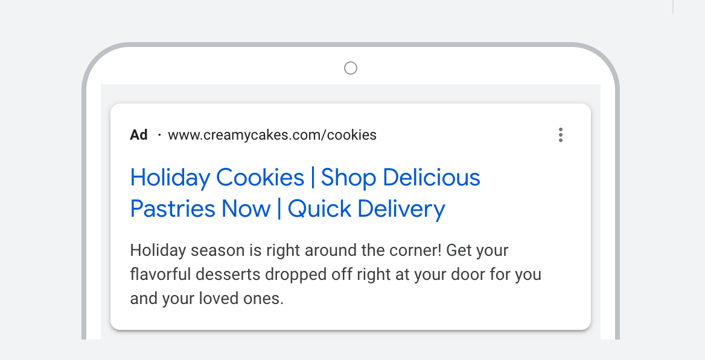

Slide 12
Adgroup/Keywords - Muffins
What are the selected Keywords for each AdGroup?
Flavors: Blueberry muffins, chocolate chip muffins, banana nut muffins, poppyseed
Seasonale: holiday muffins, apple cinnamon muffin
Relatable: muffins-corn, oat bran, plain, wheat bran,
Give Rationale as to why these keywords have been selected?
These are the most common flavors of muffins searched
Seasonality will help for people wanting specific muffins for the winter season
Other words closed tied to in relation with muffins on google search

Slide 13
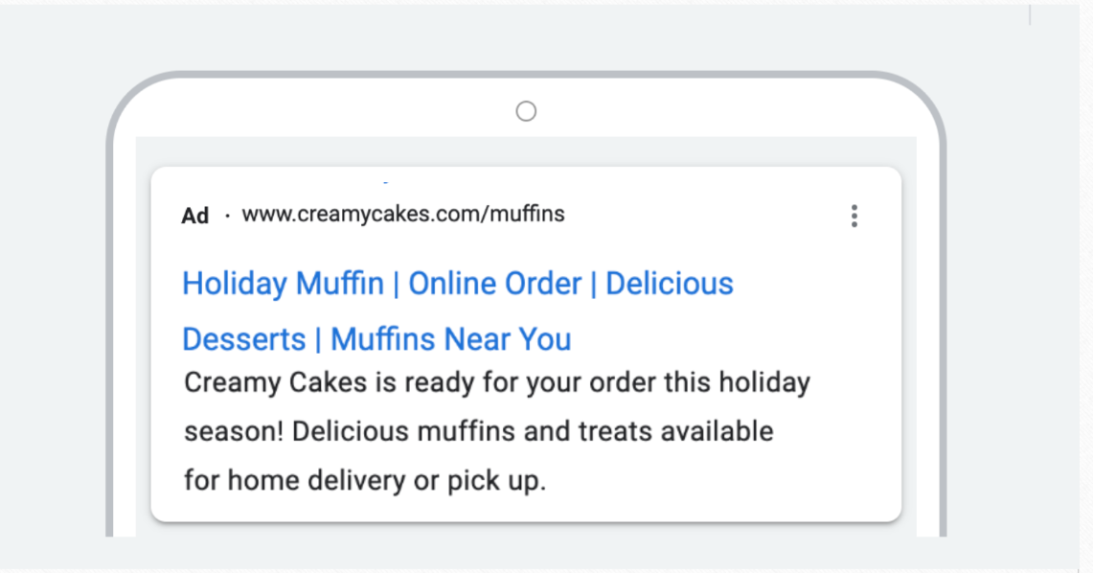

Slide 14
PART 2: DISPLAY ADS
The firm is planning to start a Display Ad Campaign to improve traffic to store by 15%.
You are the marketing manager responsible for the design and implementation of this ad campaign.
Design a Display Ad Campaign.

Slide 15
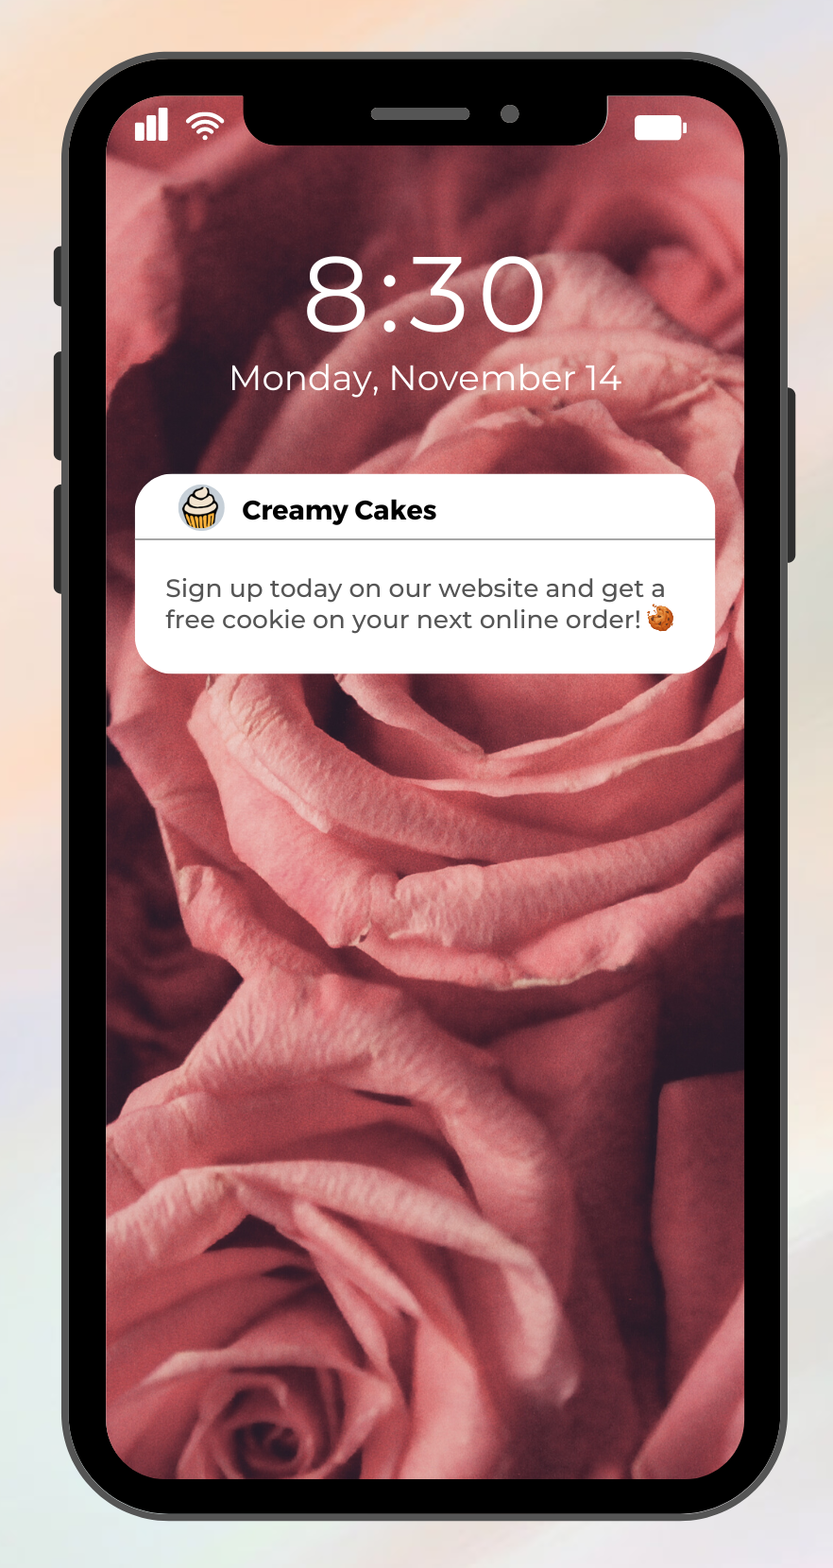
Mobile Banner - About
Mobile Banner Ads are easy-to-employ display ads that guarantee:
massive reach
increased brand awareness
and added customer retention.
Design

Slide 16
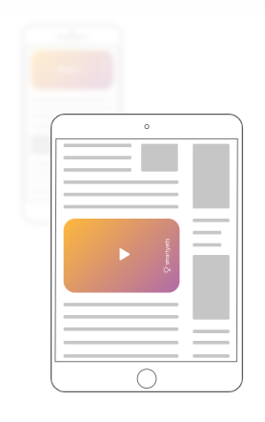
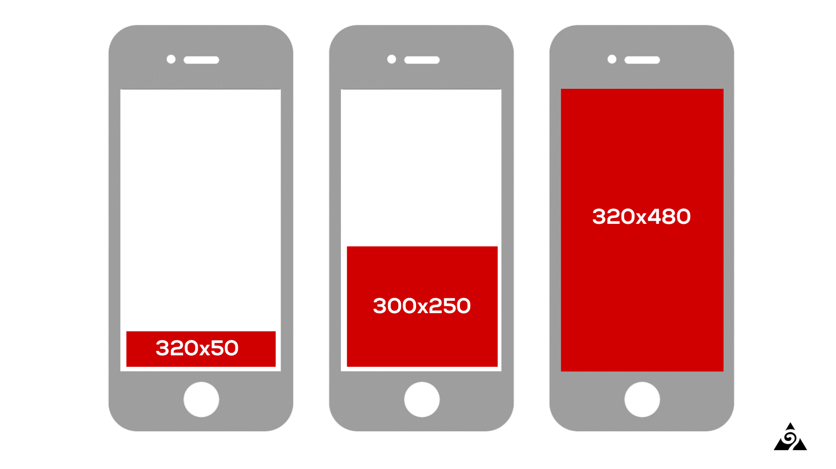
Mobile Web Ads- About
For reaching consumers while they browse the web on their smartphone, tablet, or smart device with highly responsive mobile search ads
Smartphone ad sizes: 320 x 480 px, 320 x 50 px
Tablet ad sizes: 300 x 600 px
Notes:
Source: https://smartyads.com/digital-ad-formats
Source: https://augurian.com/blog/top-10-google-ads-banner-sizes/

Slide 17
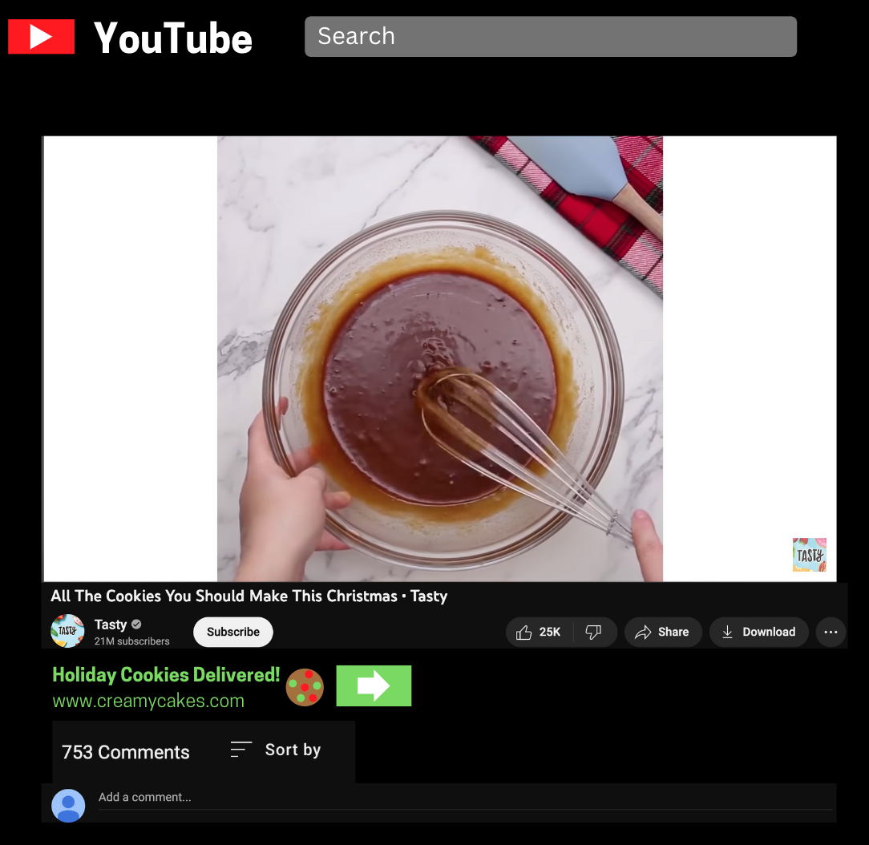


Mobile Web Ads - Design
320 x 50 px
320 x 480 px
Notes:
https://www.youtube.com/watch?v=uo2xBBLSe4c

Slide 18
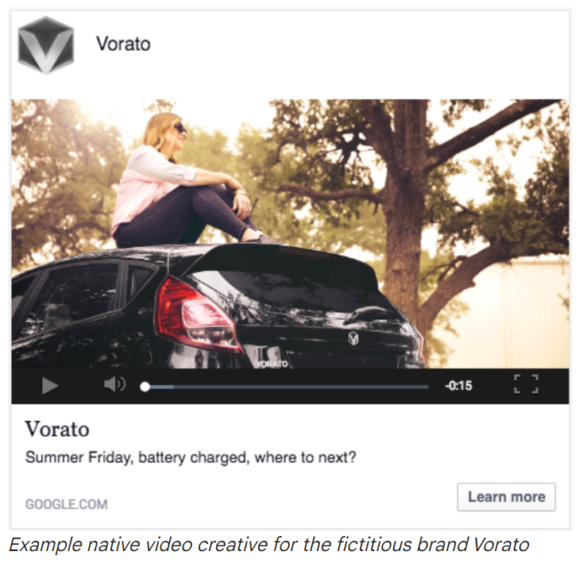
Native Video Ad - About
Example:
What it’s for:
Native video ads are display creatives with in-banner video; native video ads allow brands to use video ad placement in any type of web content (article, website, video).
Advantages:
Higher click-through rates
Non-intrusive
Highly shareable
Creative assets: video, images, copy, and call to action
Notes:
Source: https://support.google.com/displayvideo/answer/7548780?hl=en#zippy=%2Cstep-add-video-images-and-copy-in-ad-canvas%2Cpreview-while-you-create-your-ad%2Cassets-checklist
Source:
https://smartyads.com/video-ad-formats

Slide 19
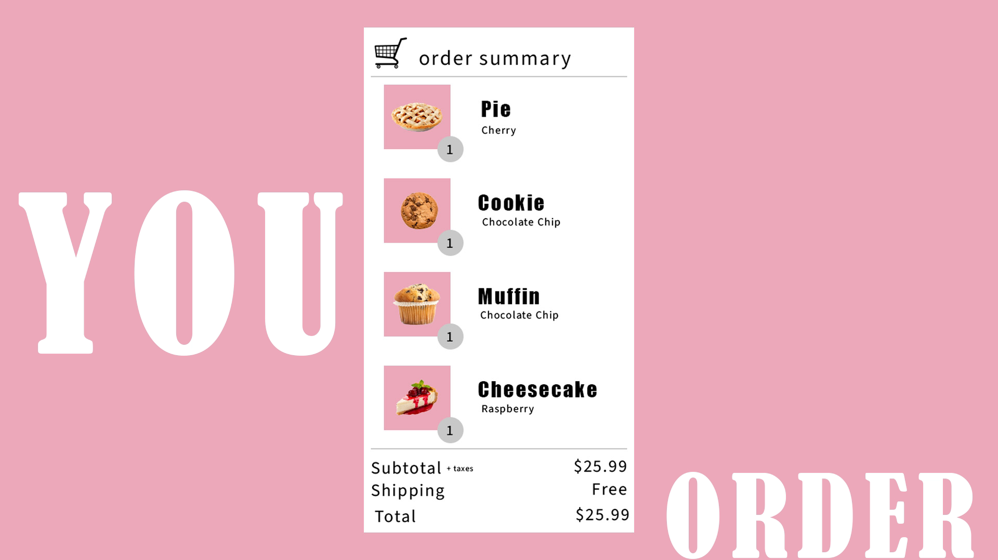

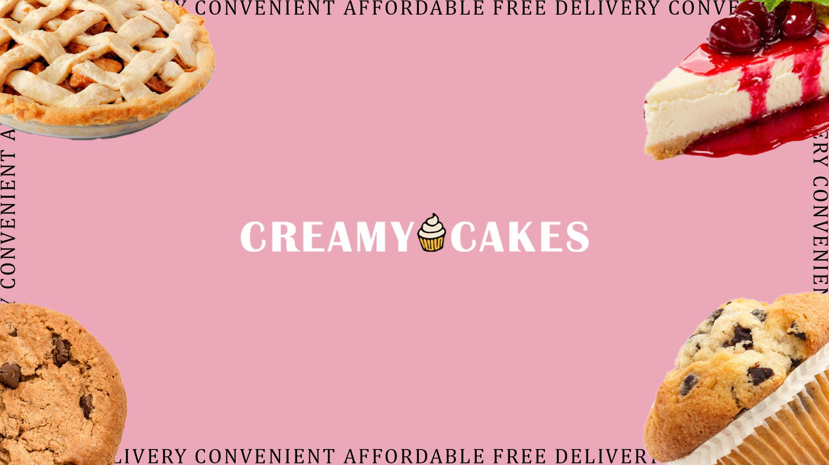
Native Video Ad - Design
Video: 16:9 aspect ratio, 1920 x 1080 px
Logo: aspect ratio 1:1, 500 x 500 px
Cover Image: aspect ratio 16:9, 1920 x 1080 px

Slide 20
Native Video Ad - Copy and CTA
Advertiser Name: Creamy Cakes
Headline: Craving something new?
Body of Text: Creamy Cakes offers free delivery when you order online for the first time with a valid email address. Shop our wide selection of flavors and desserts!
Landing Page URL: https://www.creamycakes.com/order/free-delivery
Caption URL: https://www.creamycakes.com/order
Call to action: Shop Now

Slide 21
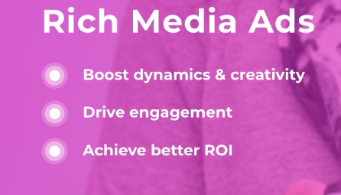
Rich Media Ads - About
Rich Media advertising format is flexible. These ads flot, play and expand on the users landing page.
There are 5 different types of Rich media ads with focus on:
Slider Rich Media ad
Slider Rich Media Ads are ads that appear at the bottom of the screen and roll along up the page as the user interacts with the page and scrolls. These ads have higher CTR and better engagement.

Slide 22
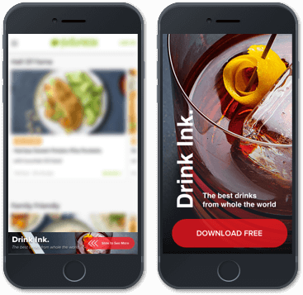
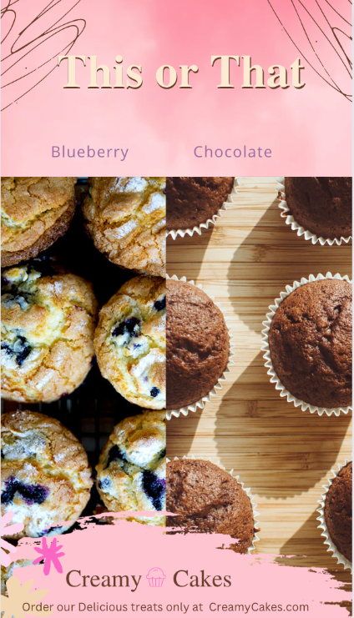
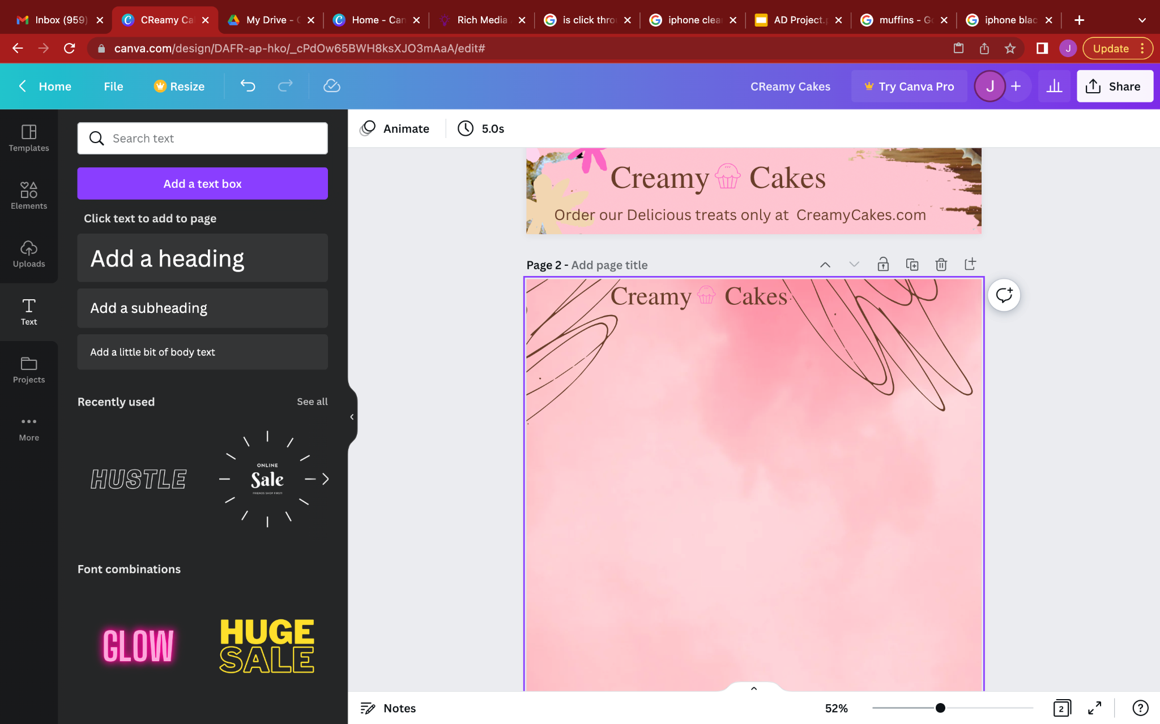
Rich Media Ads - Design
Slider Rich Media Ad
This ad starts at the bottom and blurs out the webpage and then slides up with the user to reveal the ad.
This will be perfect for Creamy Cakes to increase engagement and their CTR.

