Slide 1
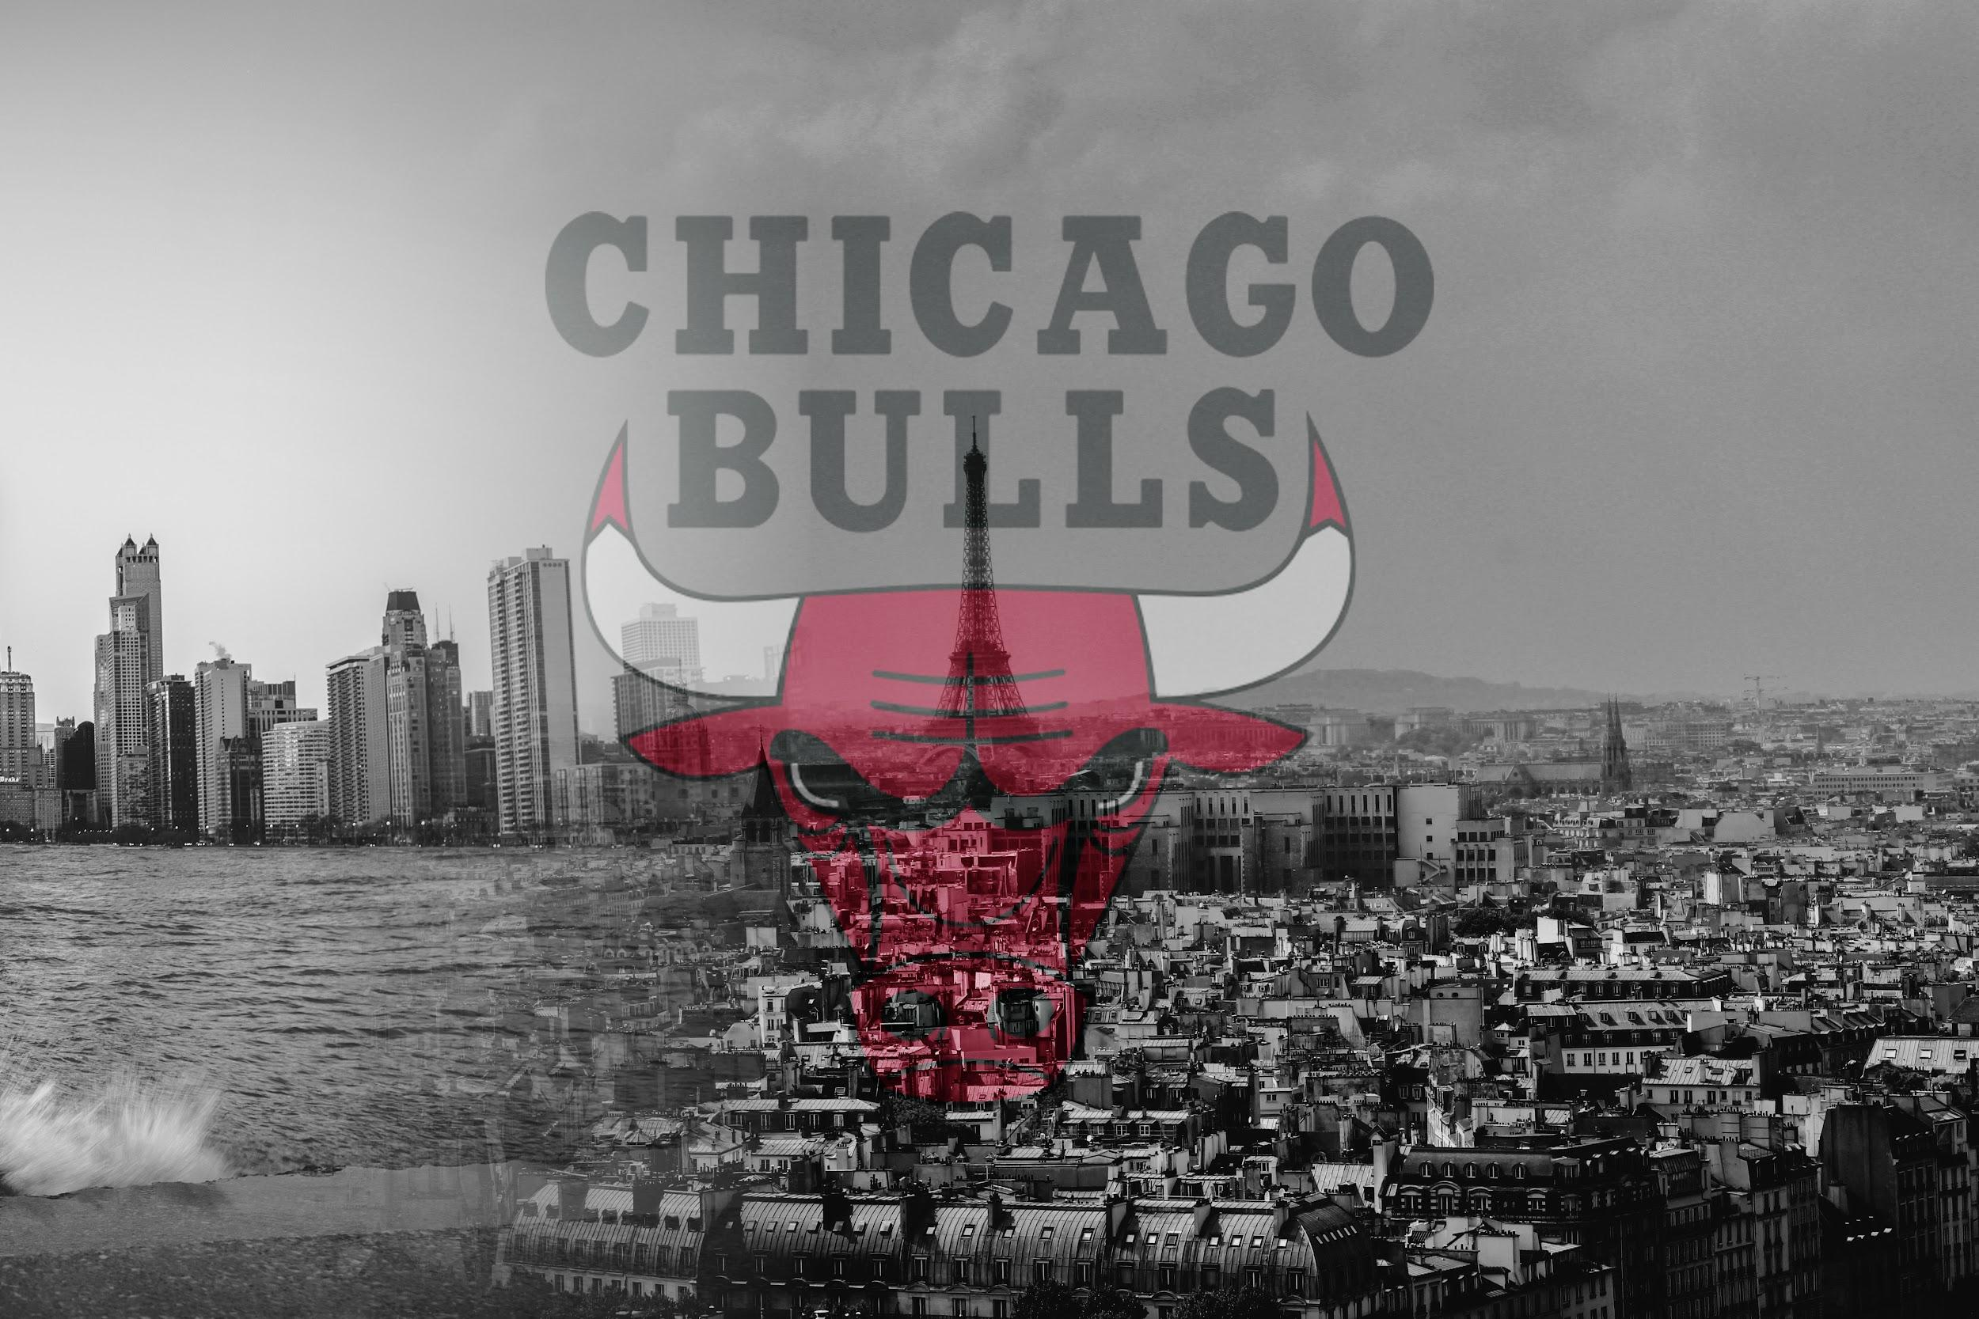
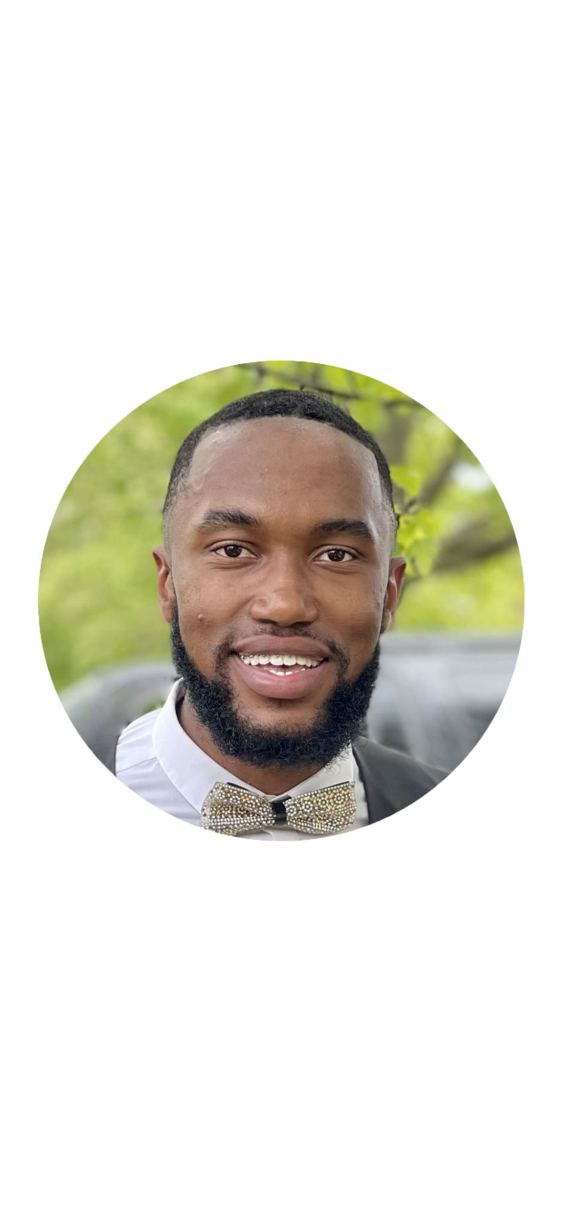
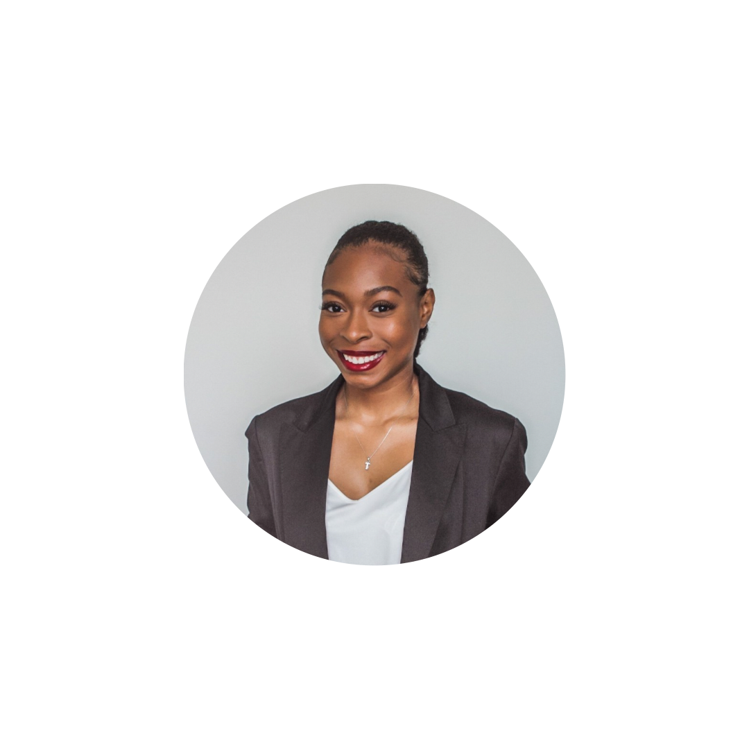
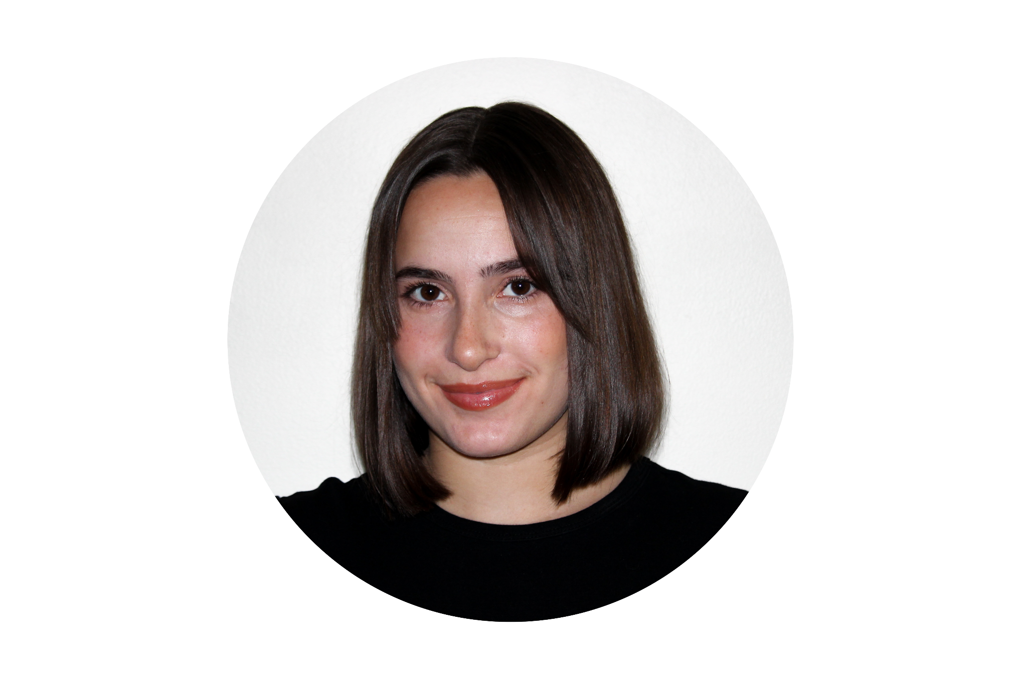
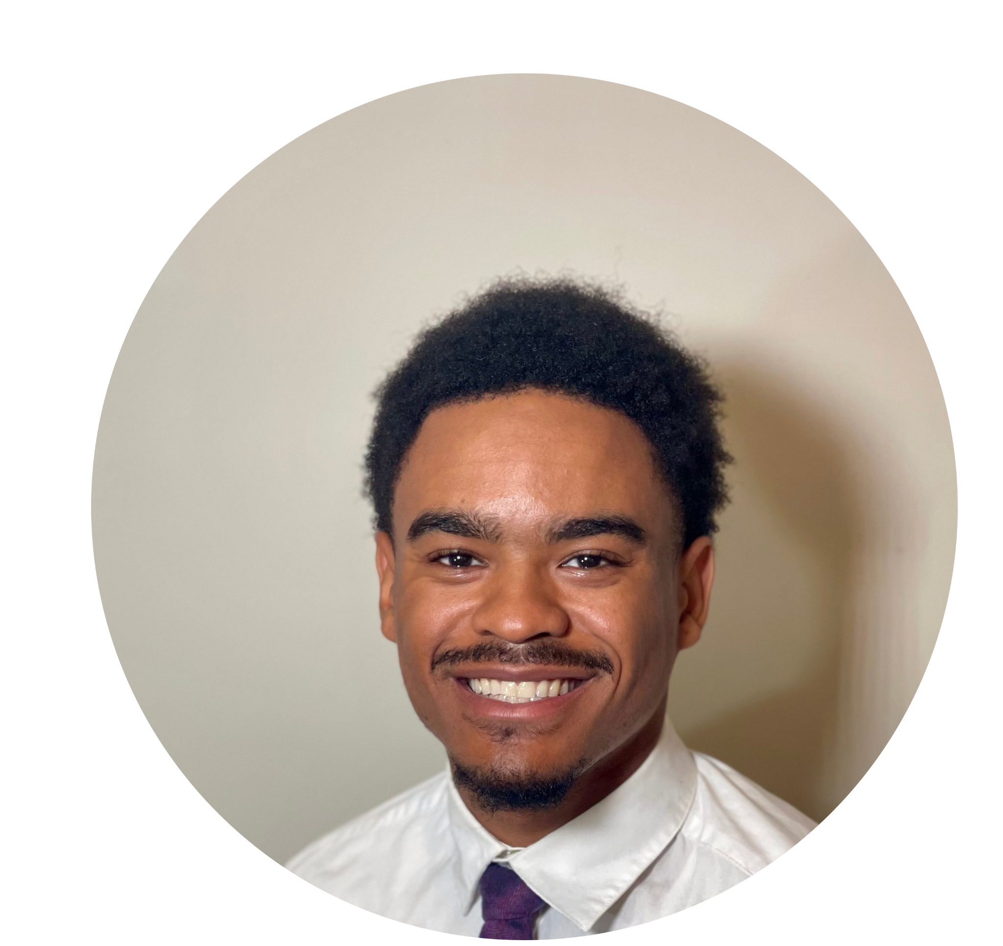
Team - MC46
Kyra Kroll
Trinity White
Ty Jenkins
Carlon Peterson

Slide 2
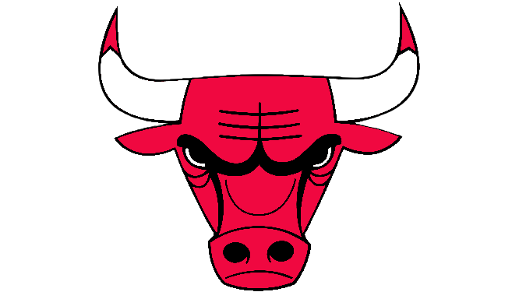
Agenda
History & Opportunity
Consumer Profiles
Goals & Objectives
French Fans
Our Campaign
Pigalle Basketball Court
Louvre and Basketball
Arc de Triomphe
Research
Creatives
KPIs
Closing/Questions

Slide 3

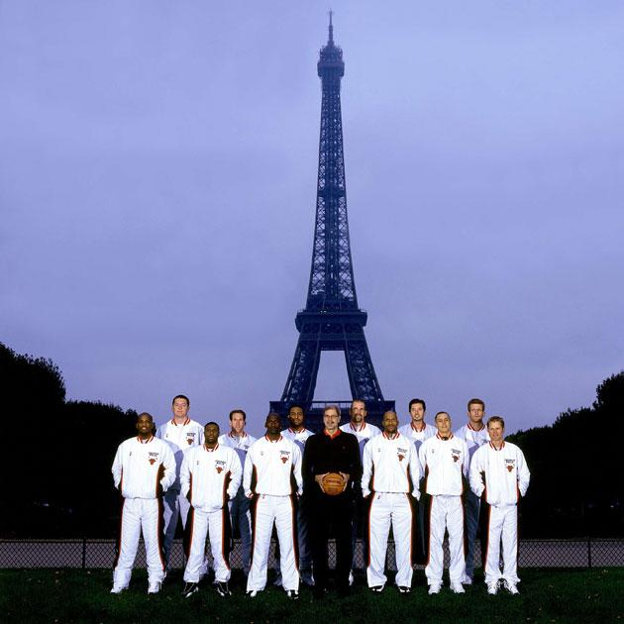

History and Opportunity
The Chicago Bulls visited Paris in 1997 for the McDonald’s Tournament and won
  MJ was the global focus - heavily talked about in the media
For the second time, The Chicago Bulls will be going to Paris in 2023– but without MJ
The Chicago Bulls going to Paris in 2023 presents an opportunity– to establish themselves as a global brand without having to lean on Michael Jordan
Notes:
With the demographic being 12-32 year olds, this is even more imperative. The younger generation is past the Michael Jordan era, and we want to ignite excitement and interest with the Bulls team that we have TODAY.
Reference: https://www.chicagotribune.com/sports/bulls/ct-chicago-bulls-michael-jordan-paris-20200419-7cf44j4sjnc7lgpcubavfbv3lq-story.html
https://www.nytimes.com/1997/10/18/sports/pro-basketball-the-bulls-oui-les-bulls-almost-lose-one-in-paris.html

Slide 4
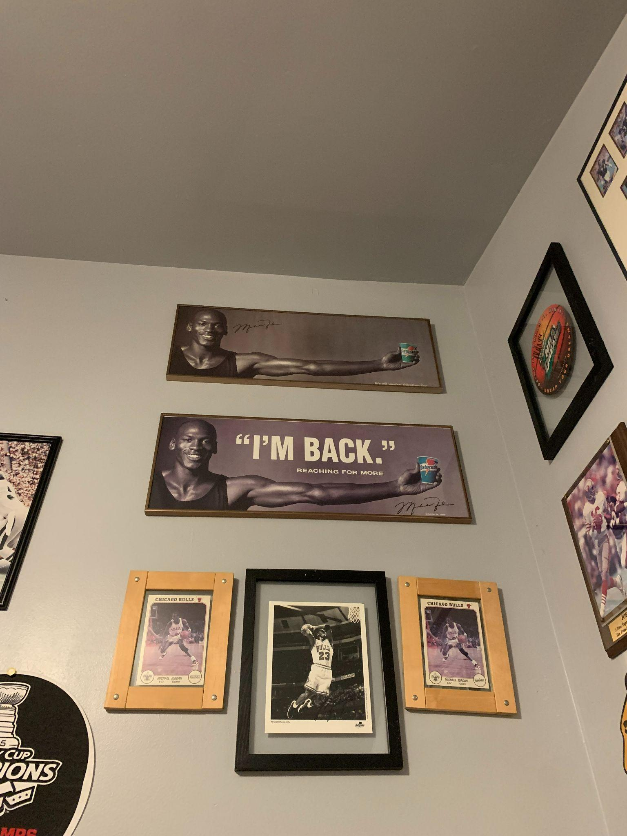
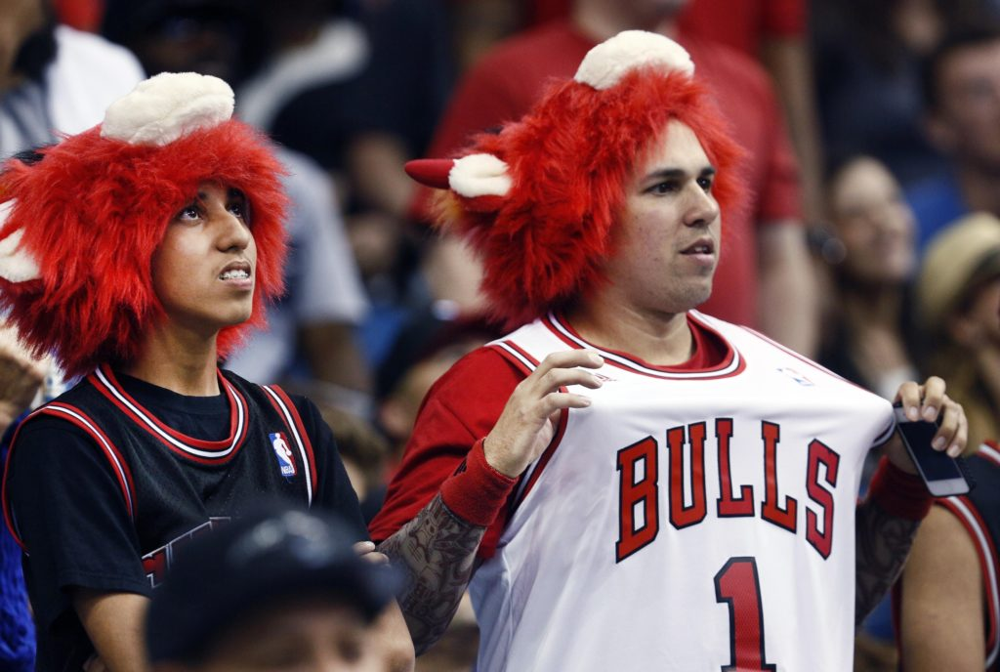
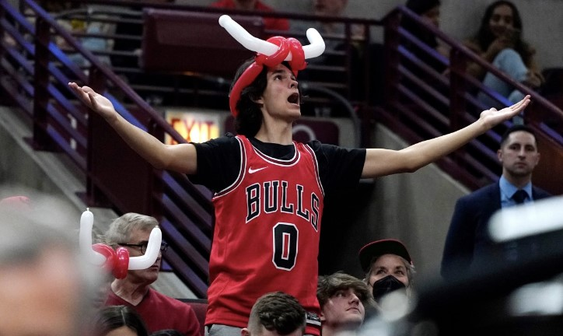
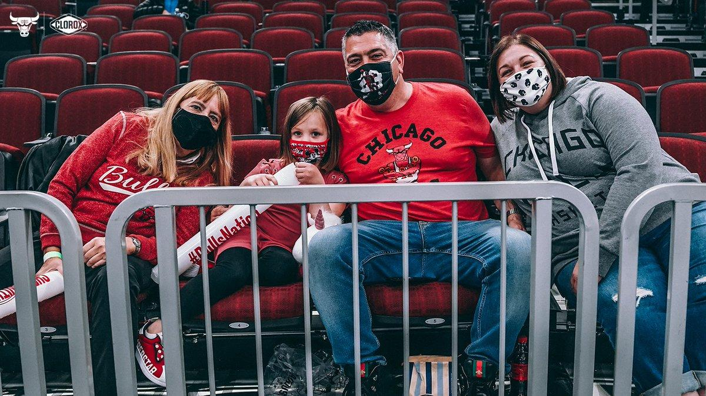

Consumer PROFILES
BOLD HOOP ENTHUSIASTS
NOSTALGIC EARLY/MID 90s FANS
12-32 YR. OLD
ENERGETIC AND FUN
YOU CAN SPOT THEM FROM A MILE AWAY
INVESTED, GOES ALL OUT
AUTHENTIC
OLDER, 32+
HAVE AN APPRECIATION/EMOTIONAL CONNECTION WITH ALUMNI BULLS PLAYERS FROM THE EARLY/MID 90S
REMINISCENT OF THE PAST
LIKE TANGIBLES THAT CAN SERVE AS MEMORIES

Slide 5

THE WORLD IS WATCHING
BULLS X PARIS 2023
Overview
Key Objectives
The Chicago Bulls are back in Paris for the NBA Paris Game 2023
The Bulls want to become the premier franchise that represents the NBA globally
The World is Watching Campaign - demonstrate that the Bulls are more than just a basketball team
Four pillars: music, fashion, and art/lifestyle culture
Execute Pari themed experiential marketing activations for target consumers
Activate Bulls brand imperatives via the four pillars
Establish a “leave-behind” seed program for ongoing fan development
Build excitement for the brand and team with next generation of French NBA fans
Reignite 90s Bulls emotional connection with legacy fans to ensure retained fan
Cultivate fans & global fandom to reinforce Bulls as France’s team of choice
Notes:
Ty

Slide 6

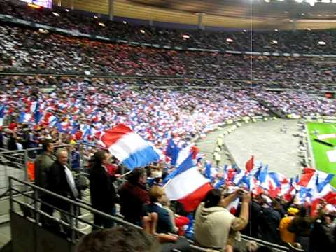
Allez!
Les!
Bleu!
Sports are a large pillar of French culture.
Fans chant “Allez Les Bleu” as they watch PSG (French Soccer Team)
Translates to “Lets Go Blue”
Patriotic chant and Sense of Camaraderie
Notes:
During PSG football games French fans are chanting “Lets go Blue!!” to bring each fan together, but we want to add a twist to their chant to represent the Chicago Bulls by saying “Allez Le Bulls!!”, which translates to “Let’s go Bulls!!”

Slide 7
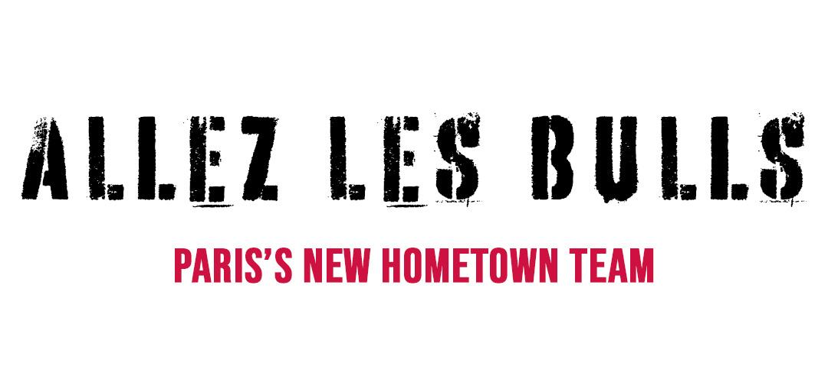
Facilitated by: Don C
Notes:
Reveals campaign name by fading name into screen
Let’s Go Bulls!!!!!

Slide 8
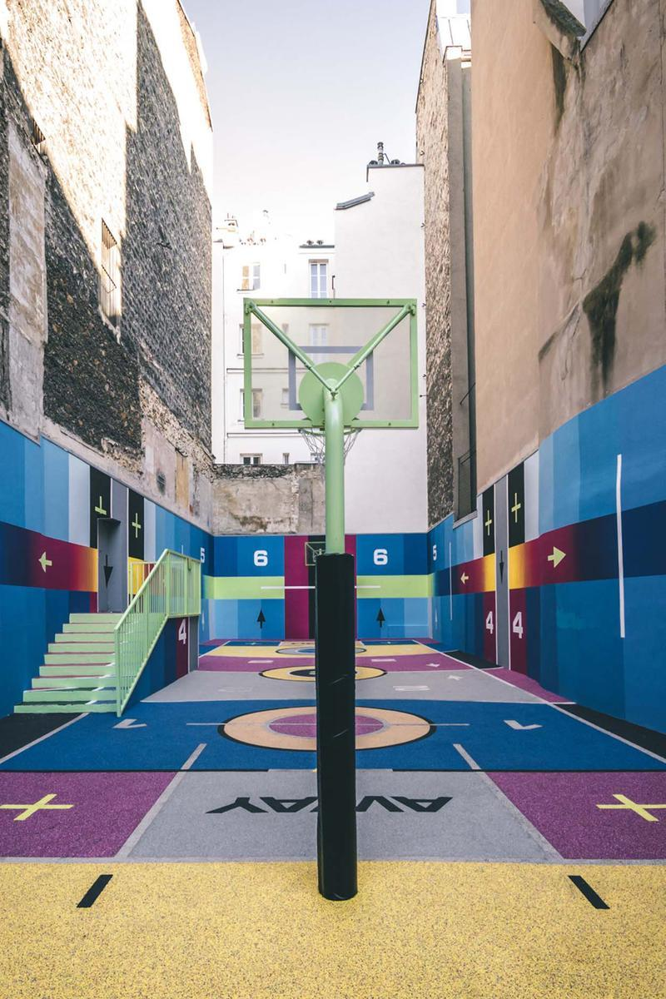
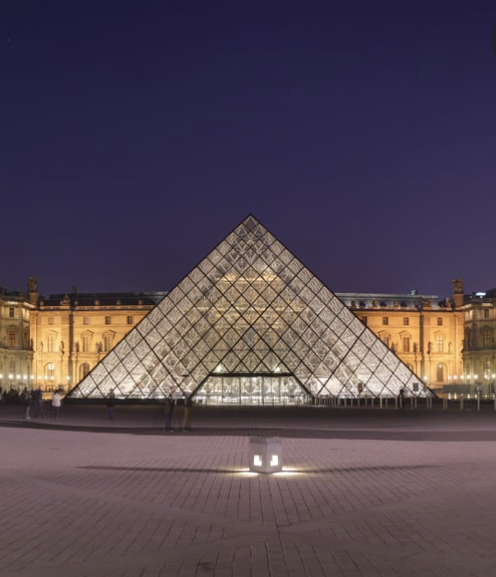
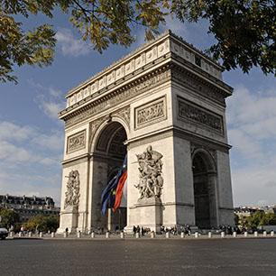
#AllezLesBulls Campaign
Pigalle X NIKE Court
Louvre & Basketball
Arc de Triomphe
Hoops
Fashion & Music
Culture
Notes:
Each event will be curated by Don-C since he is the official creative liaison of the Chicago Bulls organization.

Slide 9
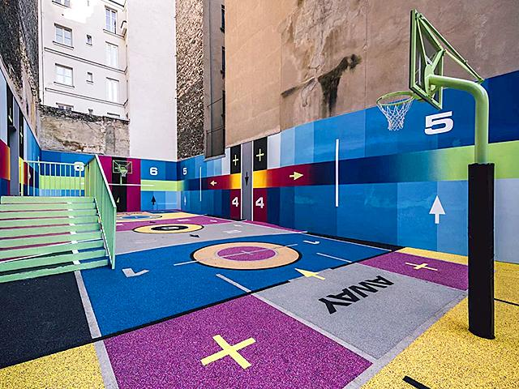
Pigalle x NIKE Court: What is it?
The Pigalle basketball court was built with the support of Nike and fashion label Pigalle in 2009
Pigalle, a Parisian streetwear label, is founded by Stephane Ashpool
The style is influenced by basketball and sports attire
Notes:
https://mybasketballteacher.com/growing-game-basketball-paris/
https://www.reuters.com/article/us-france-paris-basketball/in-paris-historic-ties-and-designer-takes-on-basketball-idUSKBN1KO1J6

Slide 10

Why Pigalle x NIKE Court
Paris has a very strong basketball scene
  Lots of decorated courts that encourage people to play
Cultural impact
  Fosters the love for basketball in the community
  Brings family together
The Chicago Bulls and the Parisian community share the same love and passion for the game of basketball
To give the Parisian community the Chicago Bulls Arena experience
Notes:
https://mybasketballteacher.com/growing-game-basketball-paris/
https://hypebeast.com/tags/stephane-ashpool
“Le Secours Populaire Francias is one the most active charities in france which a dedicated to problems related to children & poor families, provision of food 7 clothing, professional integration, access to culture, sports, hobbies, health, holidays, defense of human right..” (https://anglophone-direct.com/french-charities/)

Slide 11
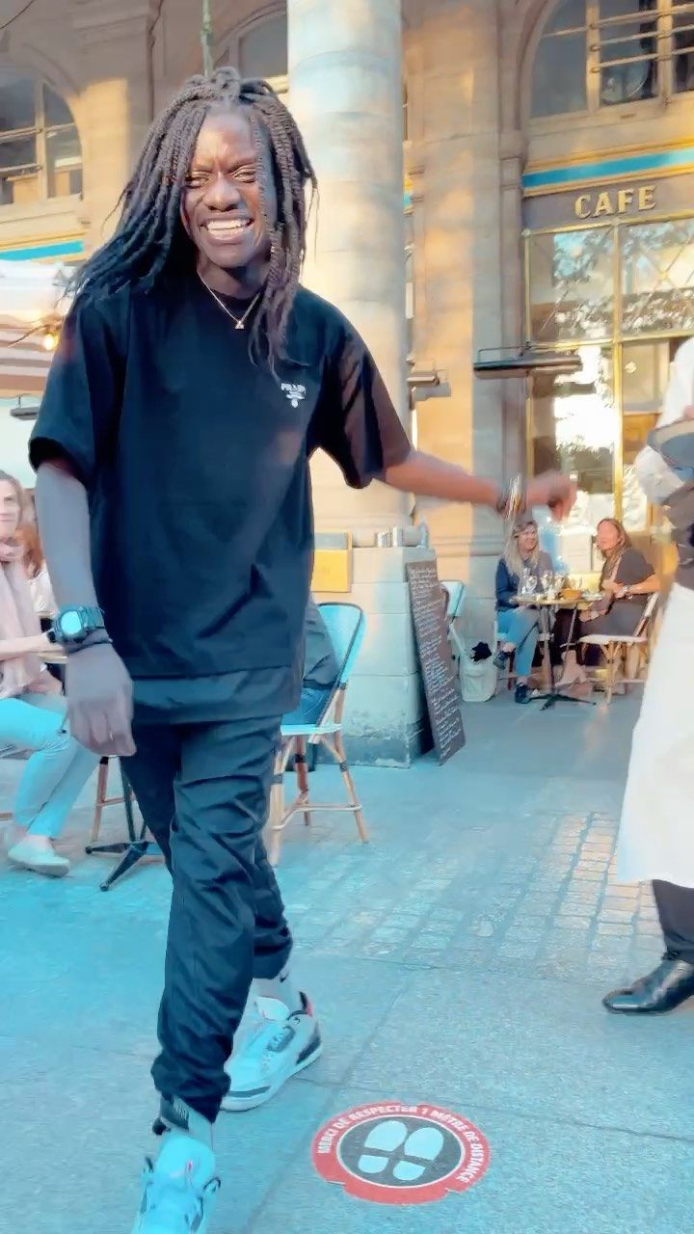

Pigalle X NIKE EVENT DETAILS
Half court tournament presented by Red Bull
  3 v 3 → day one
  5 v 5 → day two
Age divisions
  Youth/Teen: Ages 12-17
  Adult: 18+
Halftime show with Salif Gueye and Red Bull Dance
Benny the Bull Appearance
Bulls Kid Nation Implementation
Food carts with fan favorites from the Chicago Bulls Arena
Chicago Bulls signing at the end of both the 3 v 3 and 5 v 5 tournaments
Charity event: all proceeds will be donated to Le Secours Populaire Français
Notes:
https://mn2s.com/booking-agency/talent-roster/salif-gueye/
Salif Gueye is a Paris native that is known for his Michael Jackson inspired street dancing. He is also internationally recognized, which started when he uploaded a video of him dancing in Paris and it went viral. We want him to collaborate with the Red Bull Dance to showcase a blend of Chicago and Parisian style dance moves.
Food:
Food:
Vienna Beef (Hot Dogs)
Giordano’s
Lillies Southern BBQ
This Little Goat (went to the Taqueria)
Garrett’s popcorn
https://english.secourspopulaire.fr/
The charity is a non-profit that aims to fight against poverty and exclusion in France and throughout the world. This charity provides an opportunity for the Bulls to leave a lasting impact on the Parisian community. The non-profit provides emergency aid which includes food, clothing, and housing. The SPF also gives individuals access to culture and leisure as well as sport and professional integration.

Slide 12
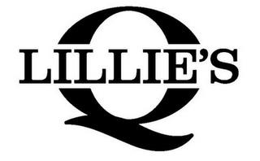

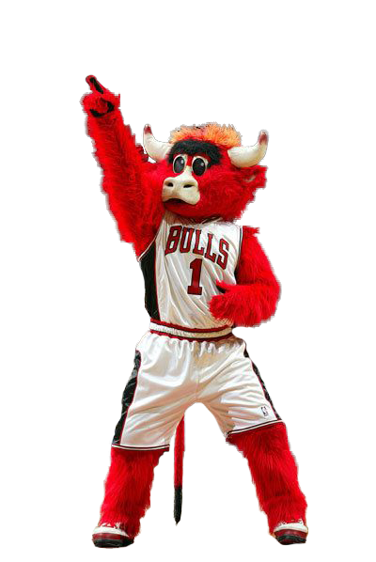

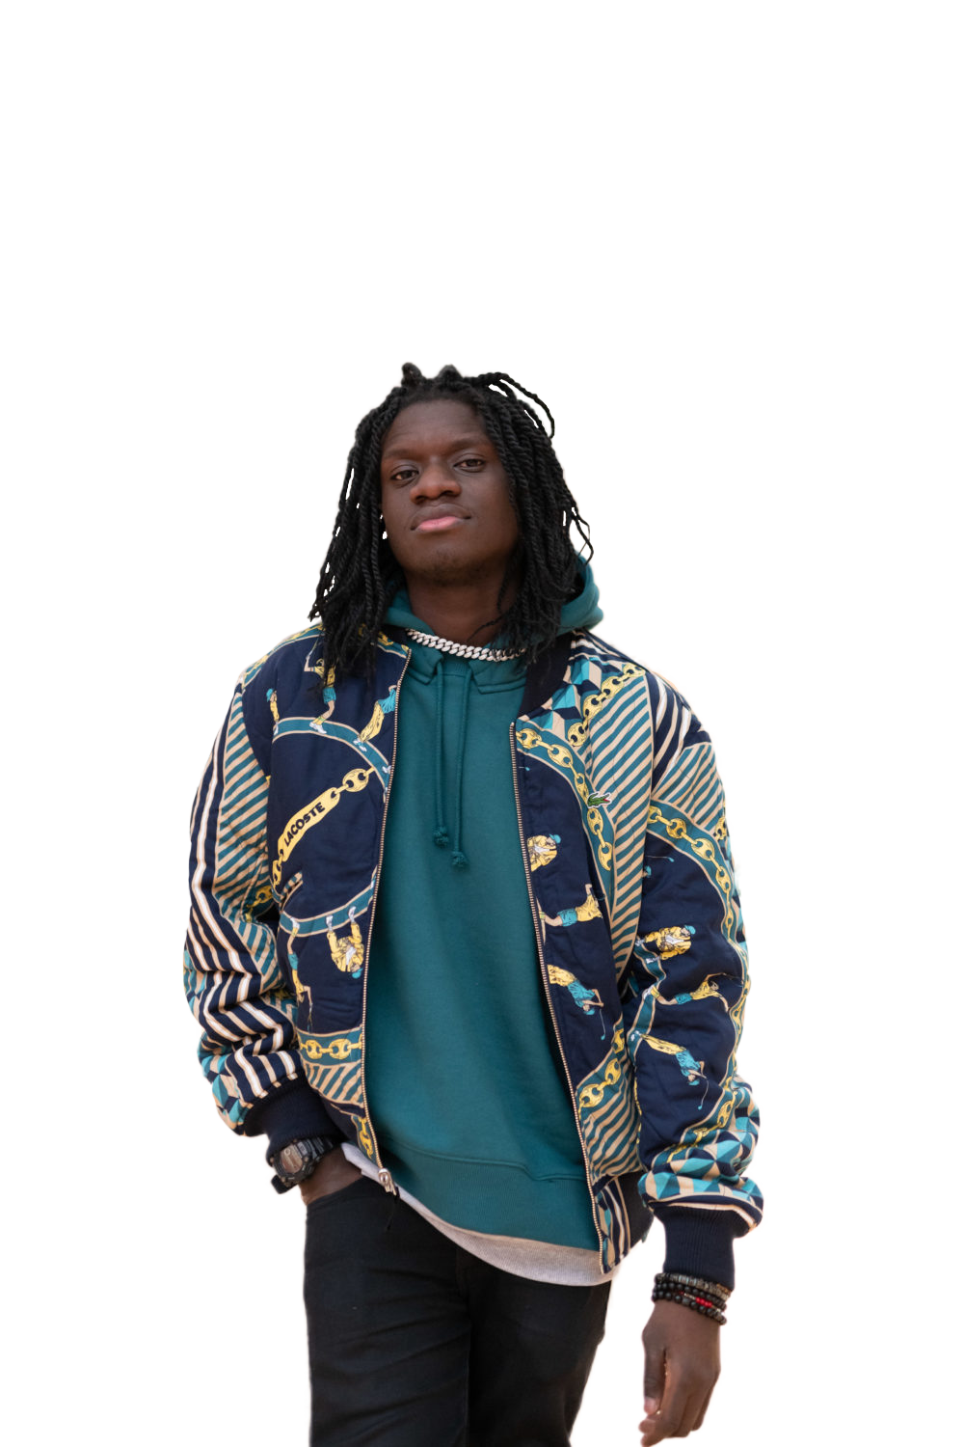



PIGALLE X NIKE Appearances and Partners
United Center Food:
Vienna Beef (Hot Dogs)
Giordano’s
Lillies Southern BBQ
This Little Goat (went to the Taqueria)
Garrett’s popcorn
Special Appearances:
Benny the Bull
Salif Gueye
The Bulls Team
Red Bull Dance
LuvaBulls

Slide 13
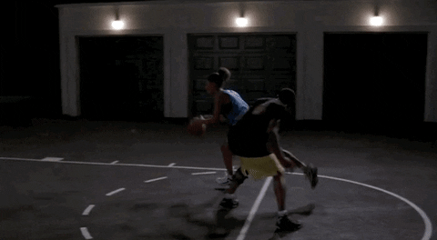
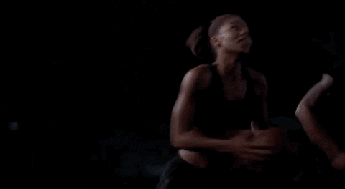
Why Louvre and Basketball
Love & Basketball (2000): play on words
Significance of the Louvre
  Cultural Influence & Impact
Notes:
https://joefreshgoods.com/

Slide 14
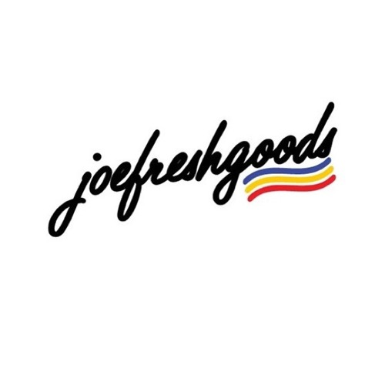

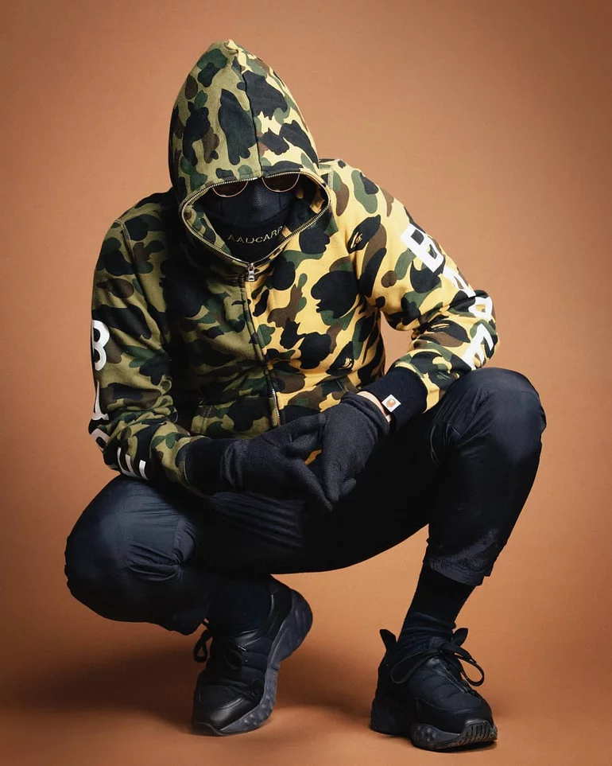
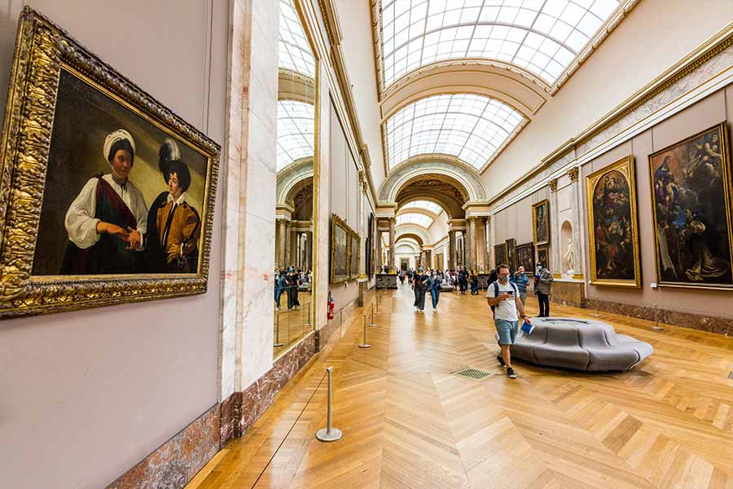
Louvre and Basketball Event Details
Event to showcase Joe Fresh Goods x Pigalle x Bulls merch collection
  Don C
Modeled by our Bulls Players and Bulls Alumni
Showroom for Bull’s Players Clothing Line (Big Baller Brand and Comp10)
Artist Performance by Kekra (French Rapper)
Available to shop in-person on Game Day
  Limited Drop Worldwide post game
  Pop-up shop in Chicago
  “Leave Behind Seed”
Notes:
Cultural Influence
Joe Fresh Goods & Don C- Chicago
Pigalle- France

Slide 15
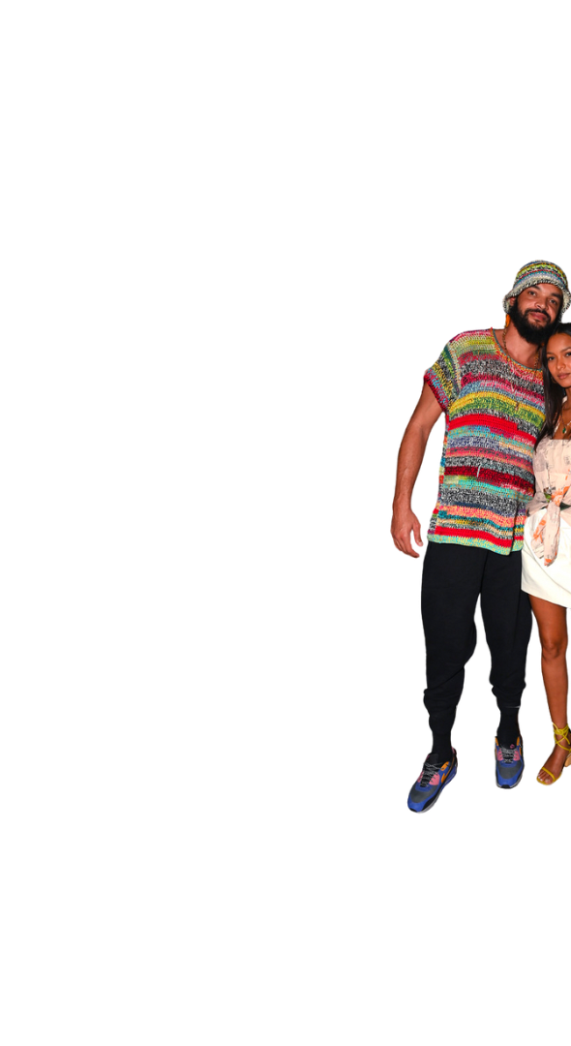
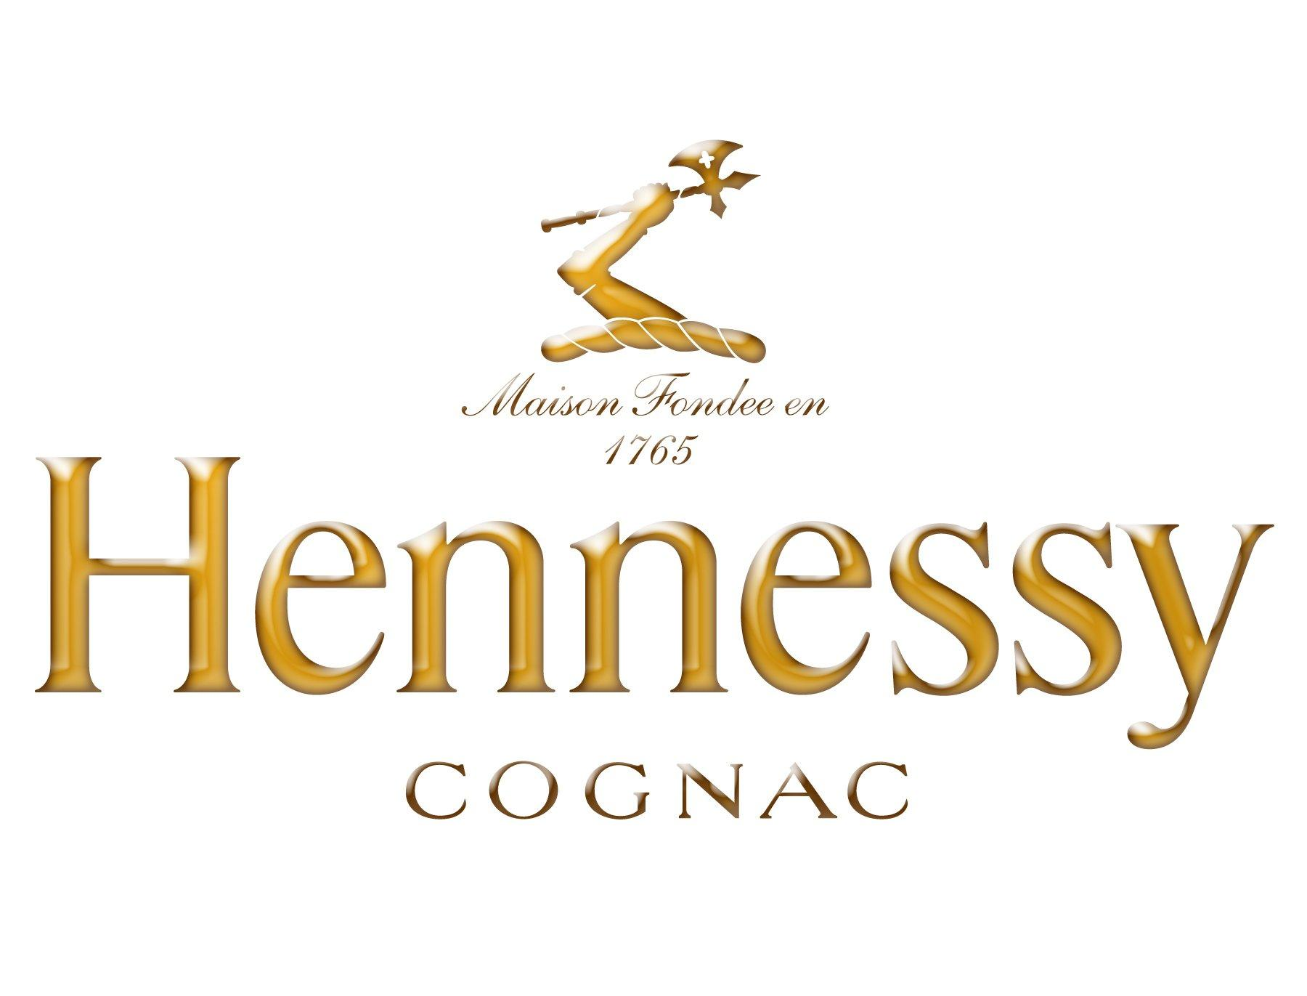
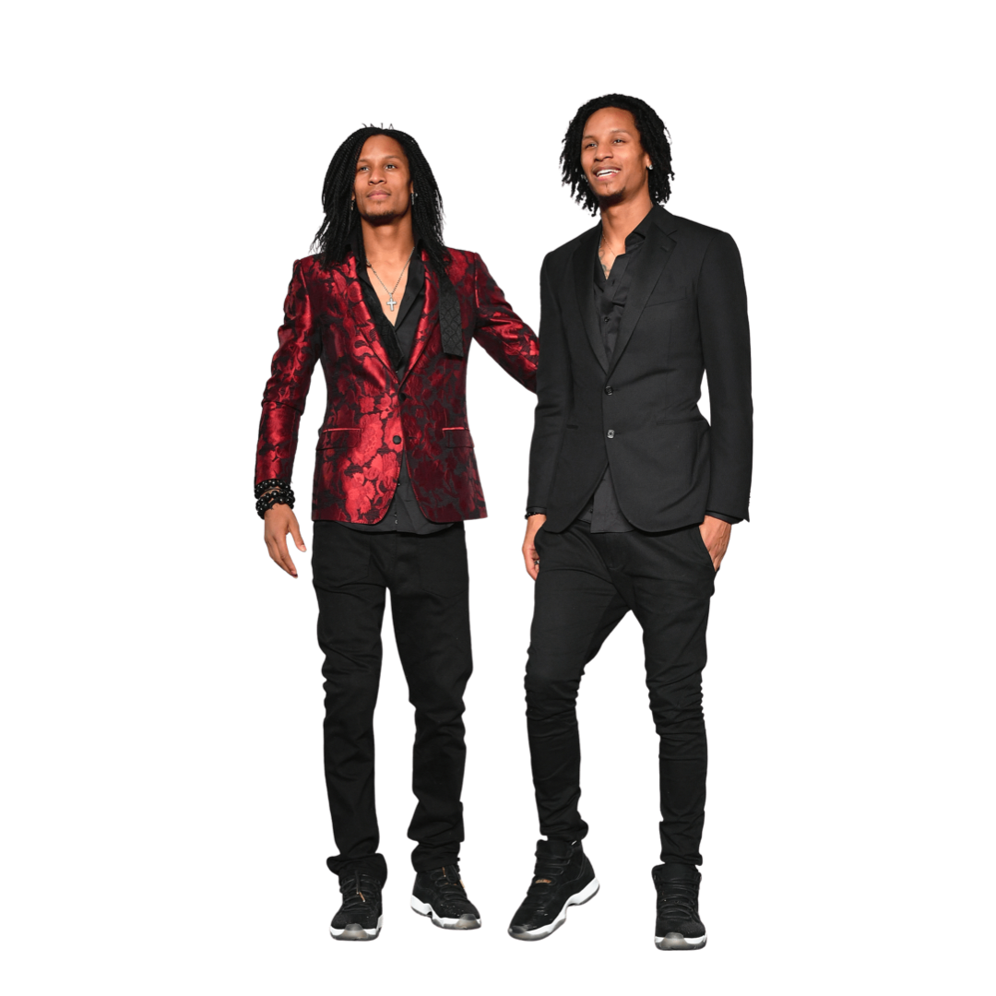
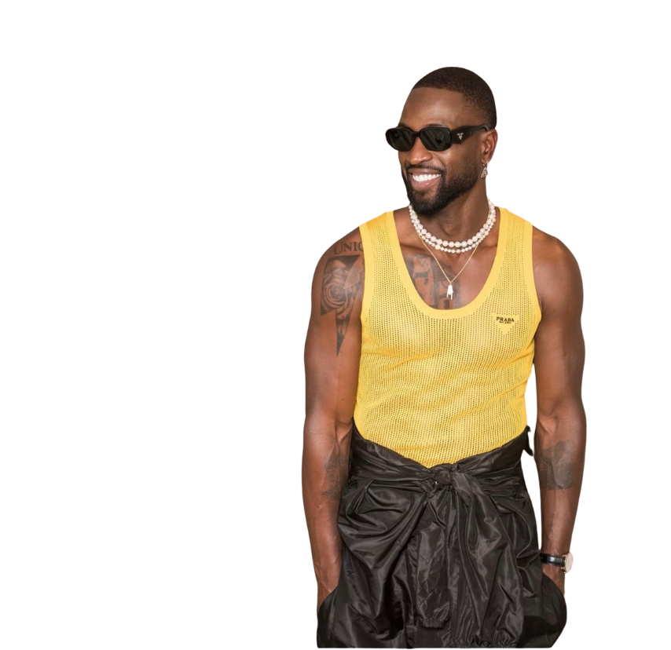
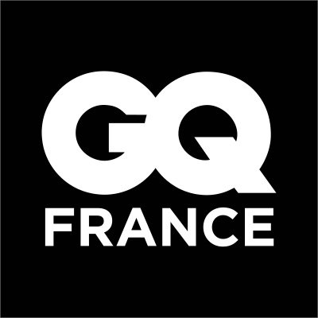

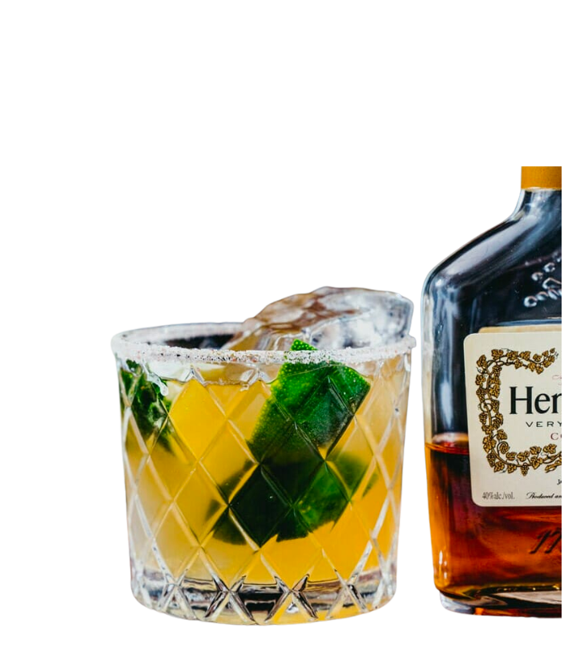
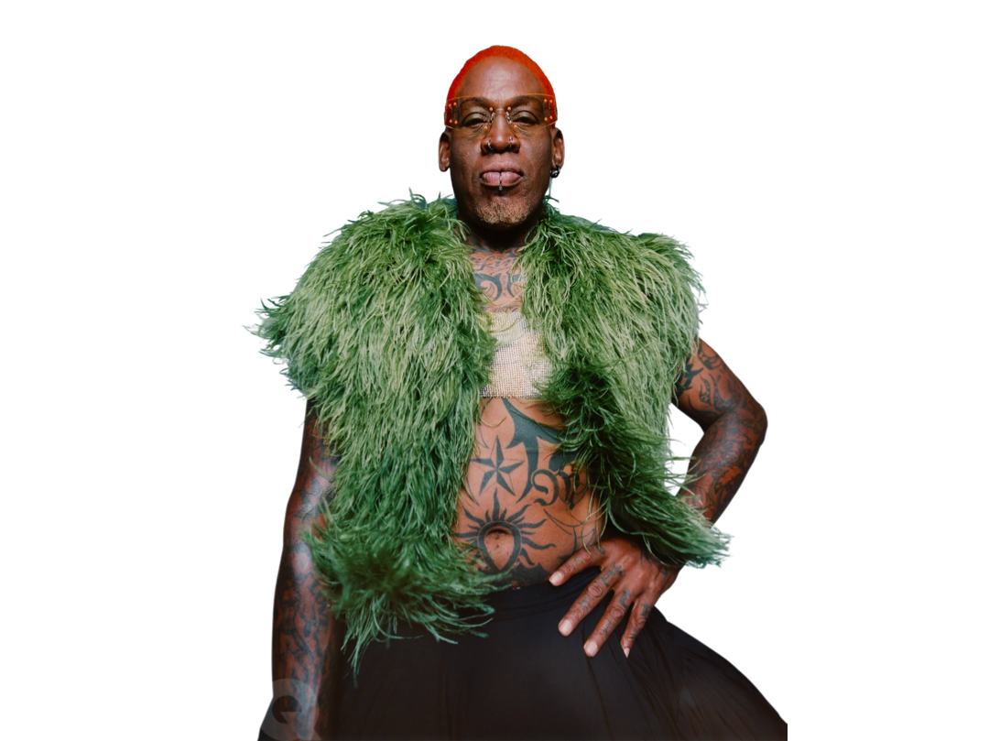

Louvre and Basketball Appearances and Partners

Slide 16
Why Arc de Triomphe
Cesar Vizcarrondo:(Chicago Bulls, Director of Brand and Fan Development)
Triomphe means “a great victory” which represents a winning culture
The word “Triomphe” is a play on the word “Triumph”, and is meant to represent the historical success of the Chicago Bulls
Special guest will be able to take fans back into the 90’s to relive the most triomphe moment
6 Championship trophies will get French basketball fans to remember the rich history behind the Chicago Bulls organization
Facebook & Youtube are the most popular social media websites used in France, which purpose is to reach fans who may not be able attend in person.
Notes:
Cesar Vizcarrondo:
It is important that this event will be held at the Arc de triomphe because Triomphe stands for “ a great victory”, which represents a winning culture.
This event will be on Facebook Live because it is the most popular social media website used in France.
6 championships represent the rich history behind the Chicago Bulls organization as we reminisce on the time those championships were won and what it meant to americans and french basketball sport fans.

Slide 17
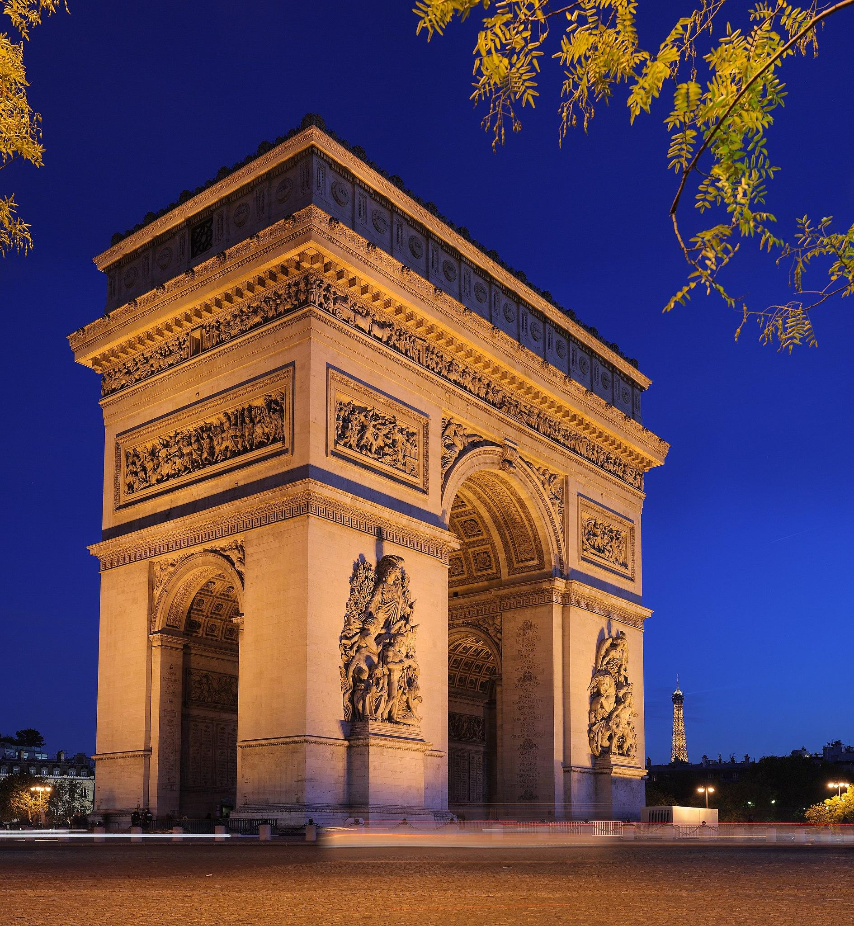
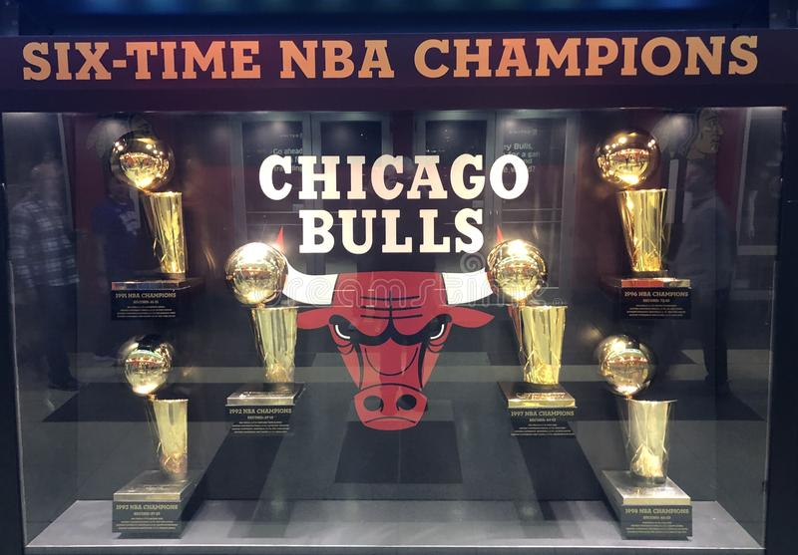
Arc de Triomphe: THE WORLD’S LARGEST TROPHY CASE
-Q&A Panel hosted by Cesar Vizcarrondo and the Chicago Bulls
- 6 Championship trophies in display
- Special guest panel:
Scottie Pippen
Phil Jackson
Thierry Henry
-Facebook & Youtube live
Notes:
Event will be held at the Arc of Triomphe
Q&A Panel hosted by Cesar Vizcarrondo (Chicago Bulls, Director of Brand & Fan development) with special guest from the 90’s Chicago Bulls team Scottie Pippen & Phil Jackson and Former french soccer player Thierry Henry.

Slide 18





Strategic Sponsorships: Why?
Notable People:
Joakim Noah
Phil Jackson
Scottie Pippen
Dennis Rodman
Thierry Henry
Dwayne Wade
Joe Freshgoods

Slide 19
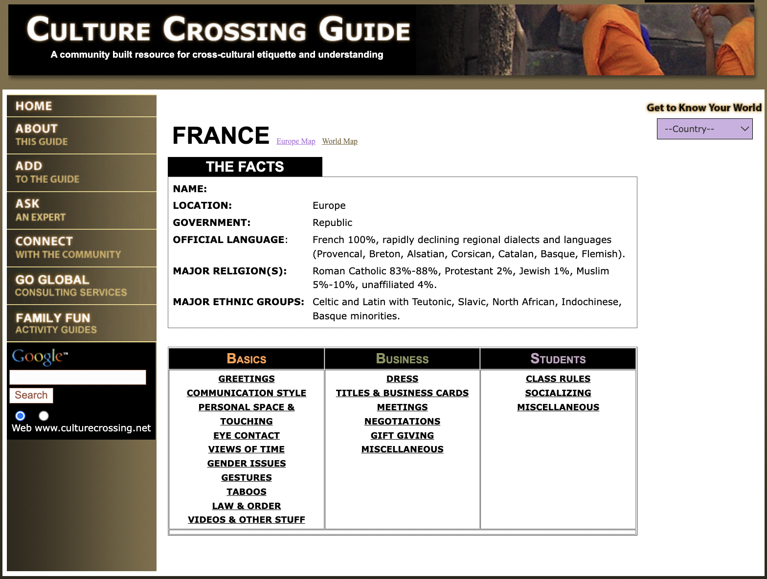
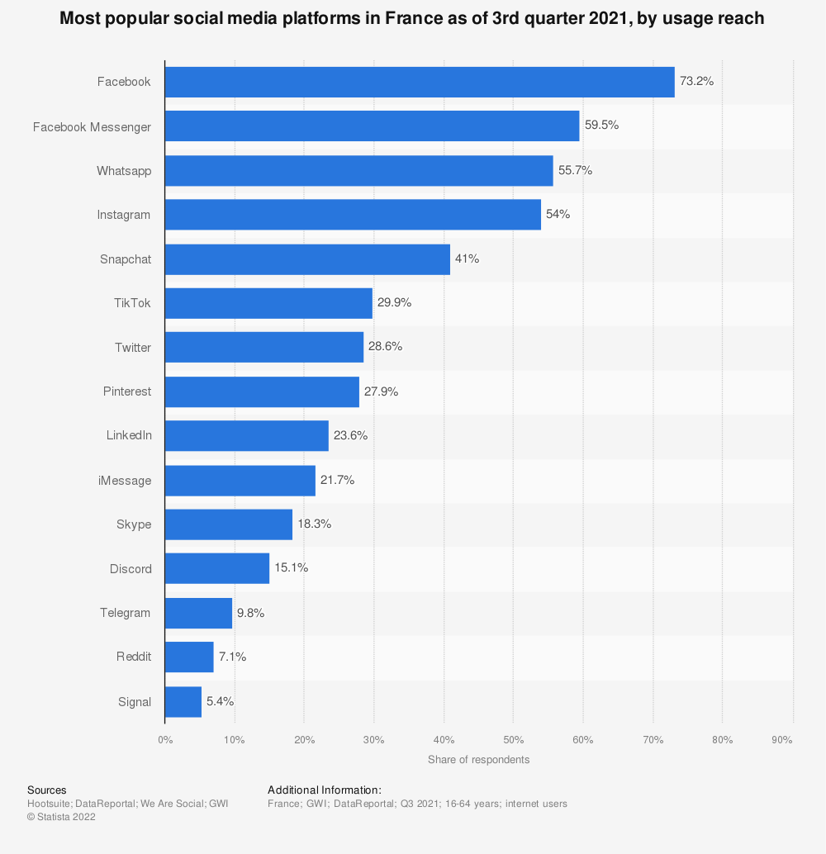
Culture and Research
Facebook is the largest social media platform used in France
Culture Crossing Guide helped us become familiar with French culture
Notes:
Ty

Slide 20
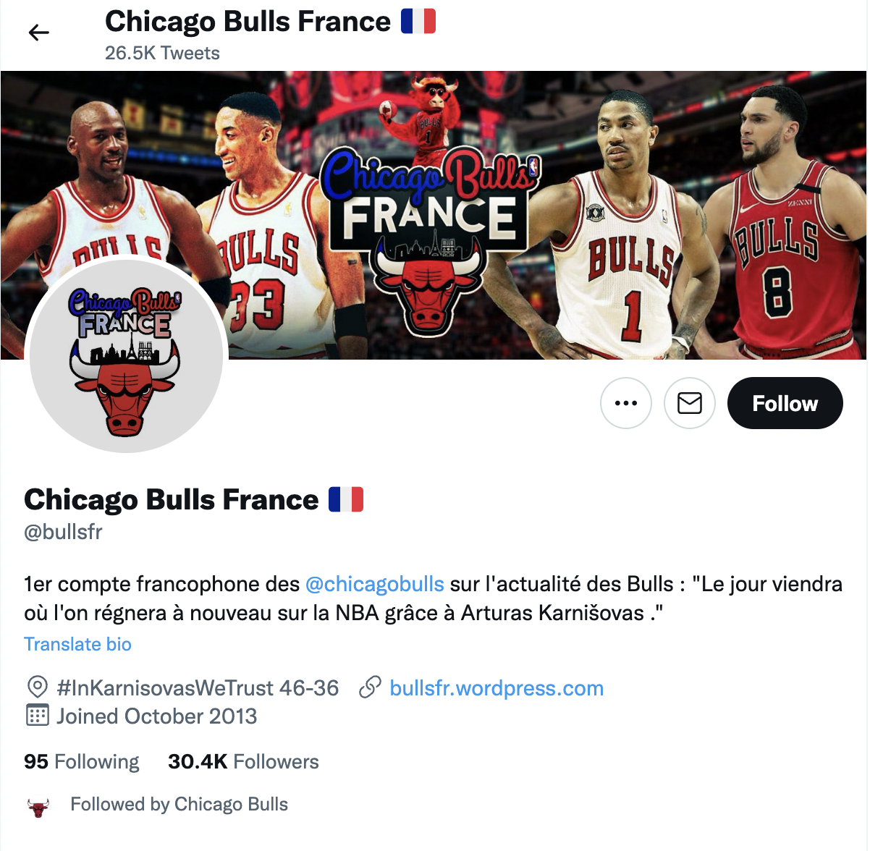
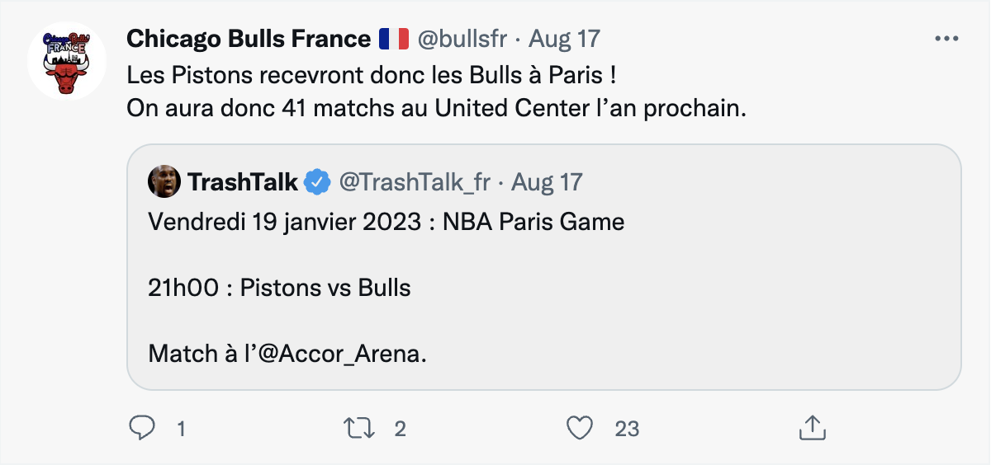
Current Chicago Bulls x France Fanbase Presence

Slide 21
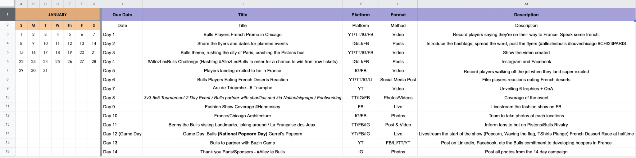
Social Media and Strategy
Notes:
Ty

Slide 22
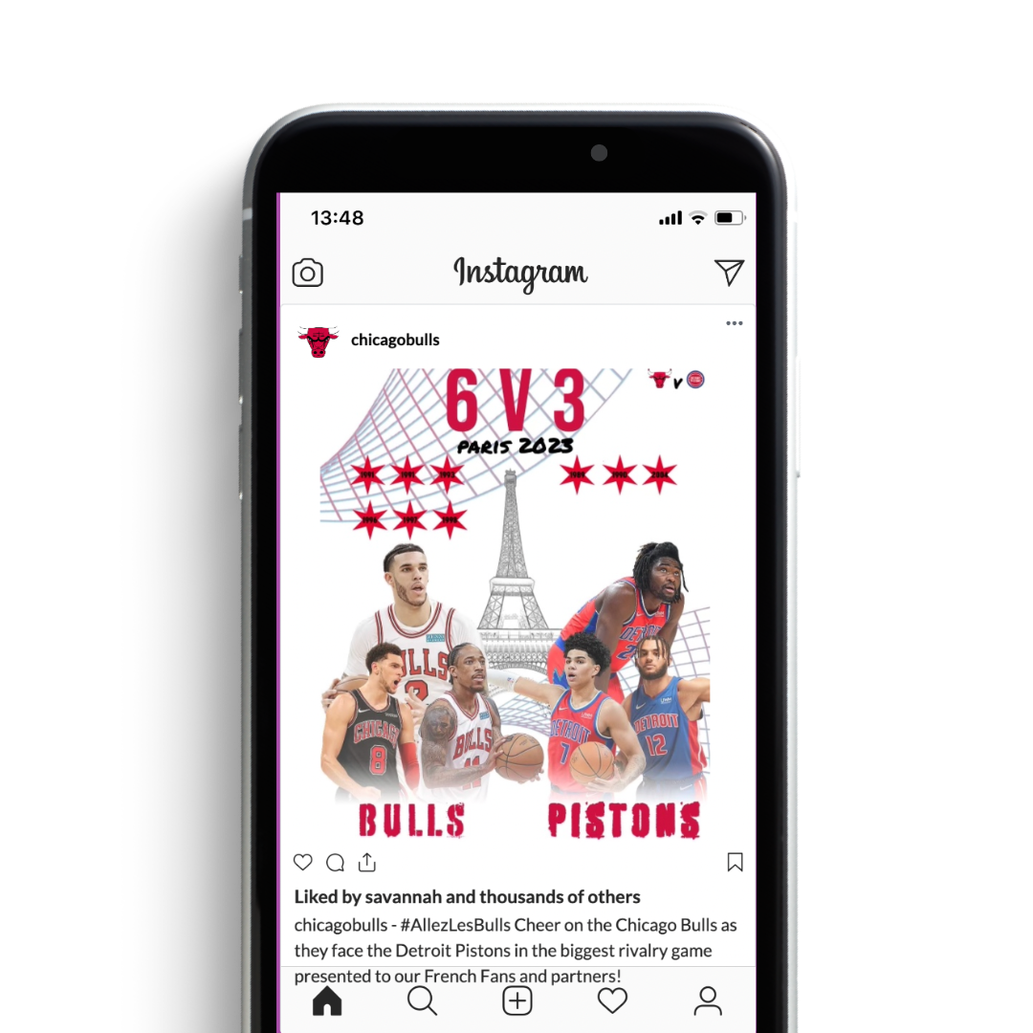
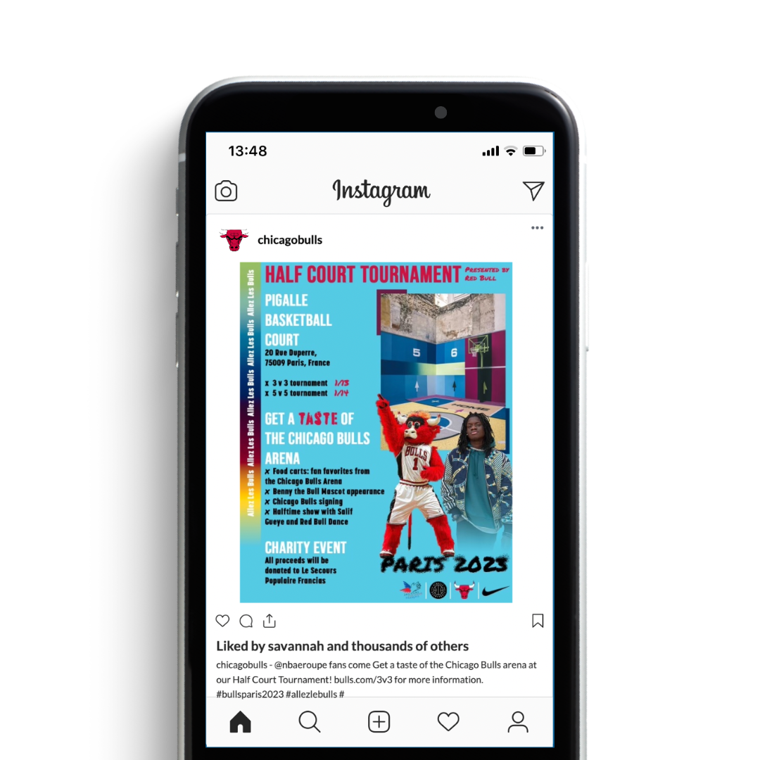
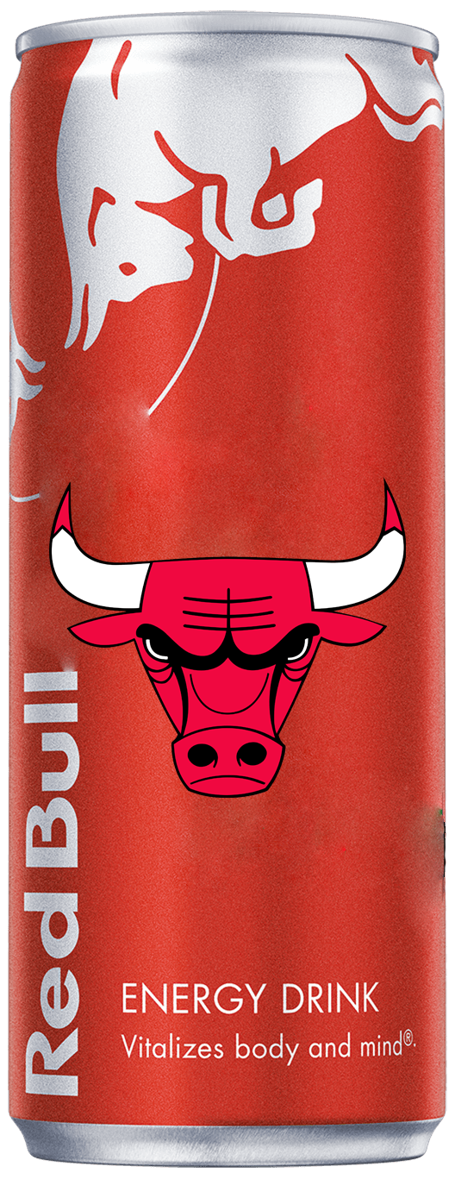
Posts and Promotional Creatives
Notes:
Ty

Slide 23
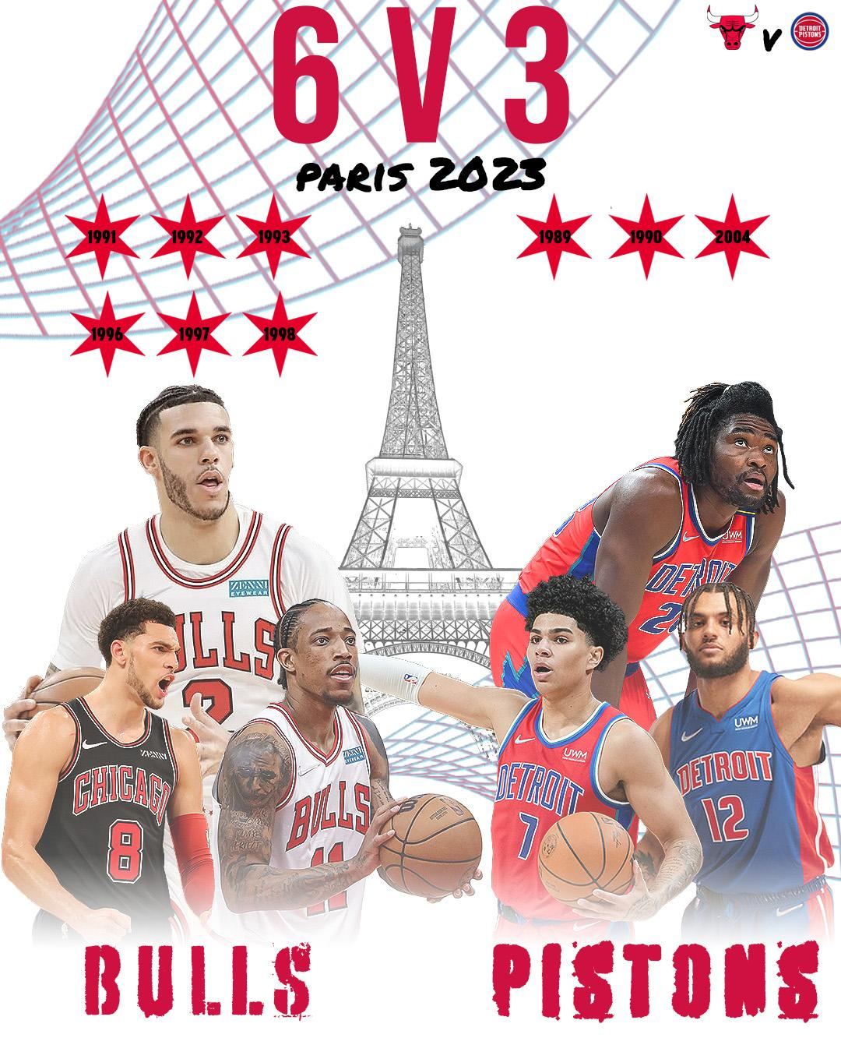
Initial Bulls vs Paris Promotional Creative
6 Bulls Rings vs 3 Pistons Rings

Slide 24
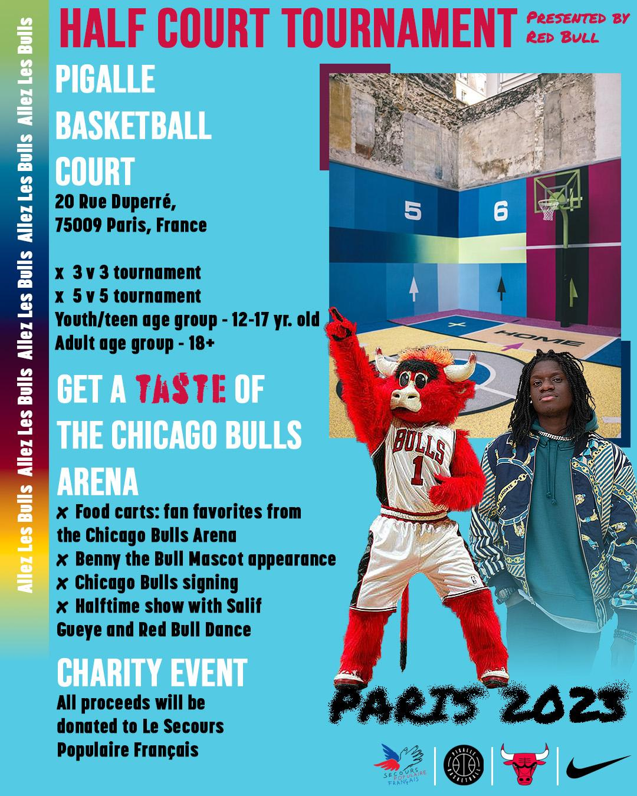
Pigalle X NIKE Promotional Event Creative

Slide 25
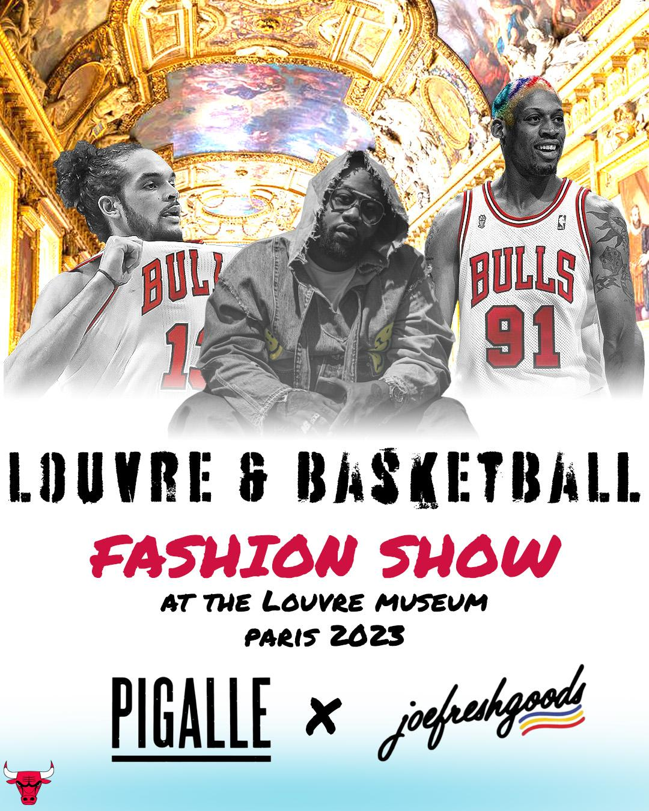
Louvre & Basketball Fashion Show Creative

Slide 26
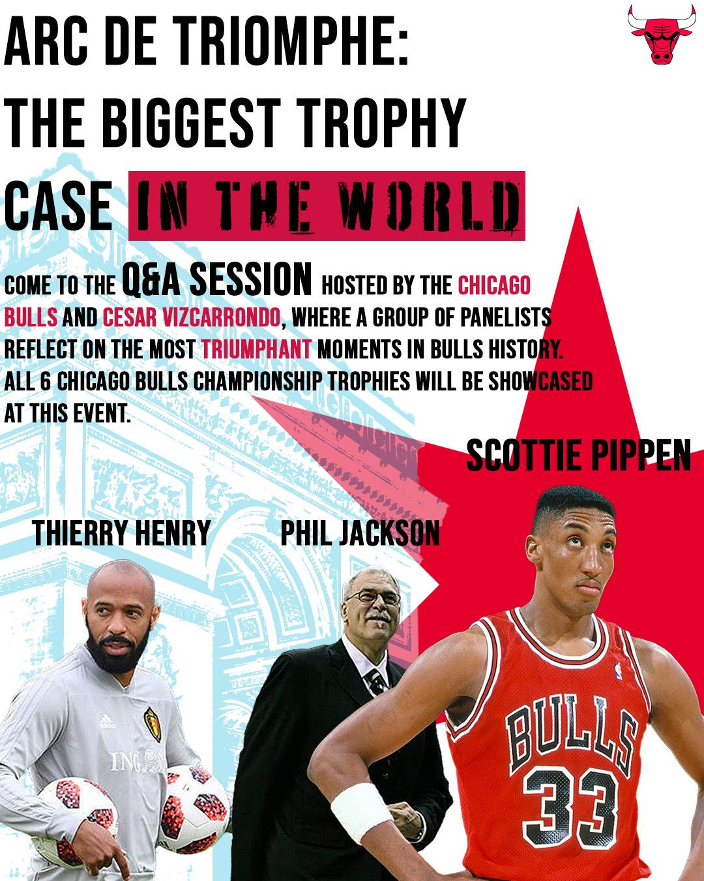
Arc de Triomphe Championship Showcasing Creative

Slide 27
BRINGING PARIS TO CHICAGO
For our season ticket holders, partners, and fans who are unable to attend the game in Paris:
  “Taste of Paris” Event
    Food carts with Parisian food on the streets of Chicago
  Pop up shop at the United Center with the Joefreshgoods x Pigalle merchandise
    The first 50 people get the merchandise
  Game day (1/19) is National Popcorn Day
    The United Center will be hosting a watch party, where all attendees get free Garrett’s popcorn while watching the Paris game with a valid ticket purchase
Notes:
Carlon

Slide 28
Measuring Success
Key Performance Indicators:
Social media
  Originality
  Likes
  Views
  Shares
  Traffic
  Is our audience engaging with our content? Are they interested?
Ticket sales / Merch sales
  Revenue
    Selling price per unit * units sold
    How much money are we making?
  Quantity Sold– how many tickets / merchandise are we selling?
  Repeat buyers
    Trial population (#) * repeat rate
    Are first time triers purchasing again?
Customer Profitability
  Durability
    % of customers who will continue to purchase tickets/merch from the Bulls the following year
  Customer Lifetime Value
  Customer Acquisition Cost
  How much is it costing us to acquire new customers? How profitable are the customers we have? How many of our current customers are staying?

Slide 29
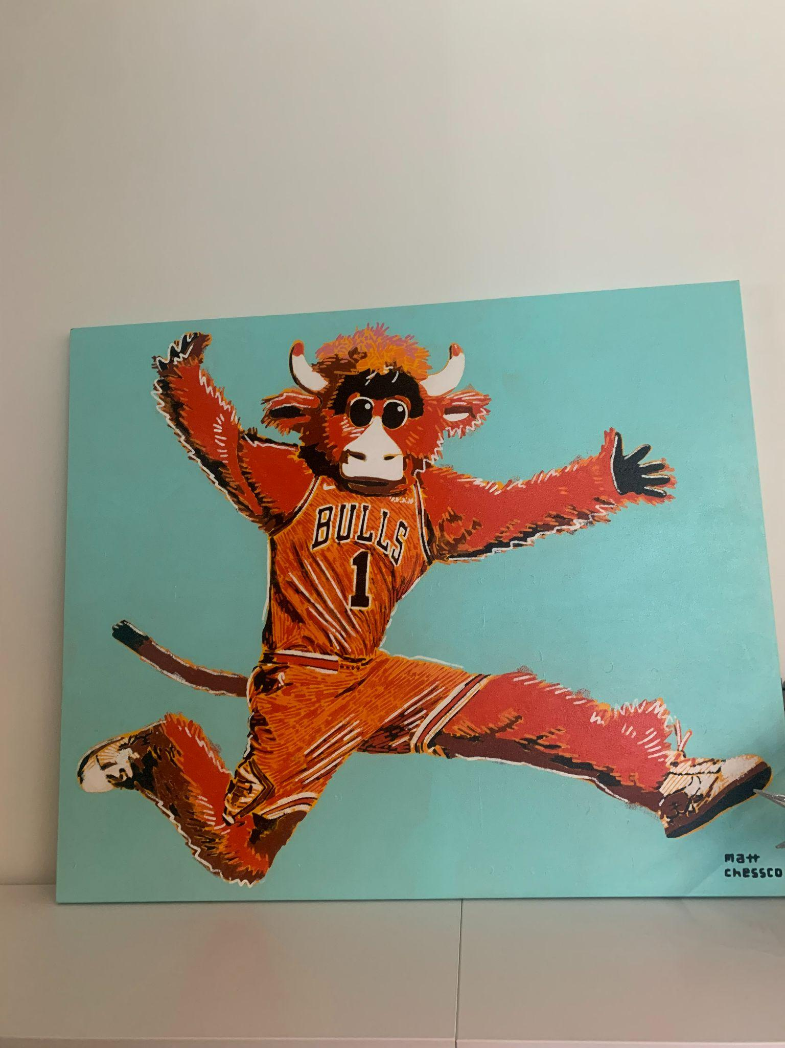
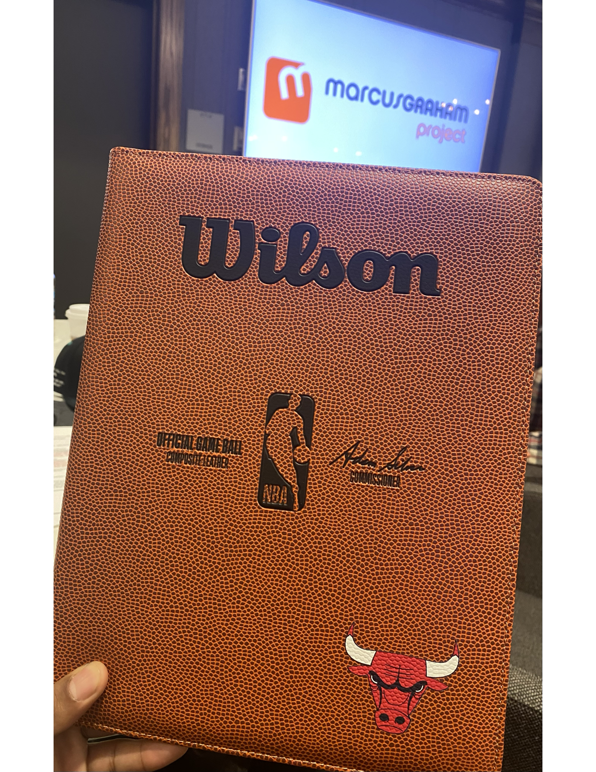
Conclusion: Q&A
Allez Les Bulls Campaign touches on 4 pillars.
Culturally immerse fans in a way that is engaging and long lasting.
Speaks to the brand in a way that reignites camaraderie and affinity.
Blends Fashion, Art, and Basketball cohesively.
Leaves digital footprint so big, French fans will forever
choose the Bulls as their home team.

