Slide 1
Case Presentation - Payless
Group 10
Anita Safari, Kyra Kroll, Yoselyn Porcayo, Joshua Muller

Slide 2
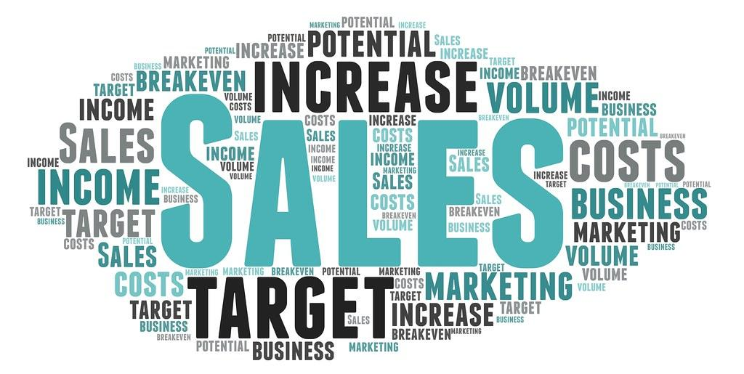
Goal
Increase website sales to 500k by end of January

Slide 3

Shannon
A DAY IN THE LIFE SHANNON
Single Mom of 3 (6,9,11)
Full-time Retail Manager
She's a planner, likes to stick to a schedule
Early Mornings, Late Nights describes her daily routines
BACKGROUND
42 years old
Associate's Degree in Management - Some College
FINANCES
She's super conscious about what she spends her money on
Household income of $50K
ONLINE BEHAVIOR
She is always active on Facebook
Buys/plans holiday gifts early in advance; capitalizes on major holiday sales/discounts
Mostly shops online, has little time to shop in person due to her heavy work schedule and busy family life
WHAT SHE’S LOOKING FOR
Affordable presents for her kids for the holidays
Business casual apparel, wants to be comfortable during a long day of work but still look professional
WHAT INFLUENCES HER
Her friends and colleagues
Facebook and social media
Youtube product reviews
MAKES LIFE EASIER
Affordable products
Easy/seamless online shopping experience

Slide 4
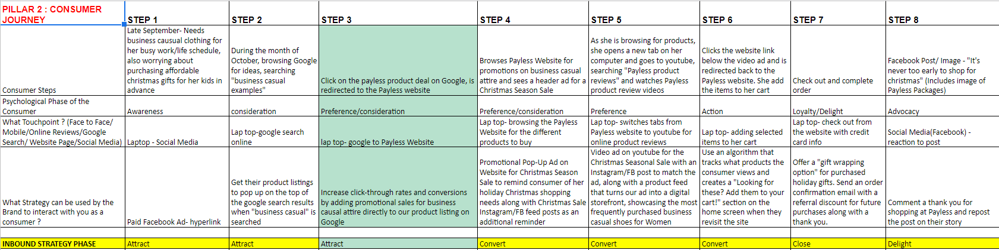
Snapshot of Consumer Journey Map

Slide 5
Map Phases & Strategy to Content
Strangers
Visitors
Leads
Customers
Promoters
Attract
Convert
Close
Delight
Blog post: "Keeping it Business Casual: Trendy and Affordable Shoes for Your Business Casual Wardrobe" hyperlink to Payless's blog/article on Facebook.
Promotional Pop-Up Ad on Website/Facebook/Instagram for Christmas Season Sale / “PLAN AHEAD Christmas sale 15% off
Website algorithm: “Santa’s Bag” - looking for these? Don’t forget to add them to your cart before you check out! Lists products that consumer previously viewed on the website with an “Add” button.
Comment a thank you for shopping at Payless and repost the post on their story
Google search product listings in Google shopping and Google search (all) that links to Payless’s website and shows business casual shoes, clearance/discount prices, company ratings, and product names
Website header- "PLAN AHEAD Christmas Sale: 15% off Christmas Sale, Check Christmas off your to-do list early, use code PLANAHEAD at checkout, Ends 11/25"/Youtube video ad: Start with the "It's an avocado... thanksss" meme. Suggest childrens' shoes (cozy slippers, light up shoes, snow boots) to add to her cart
"What she said *side eye emoji*” Payless reposts her content on their Facebook page story.
Offer a gift messaging / "gift wrapping option" for purchased holiday gifts. Send an order confirmation email with a referral discount for future purchases along with a thank you

Slide 6
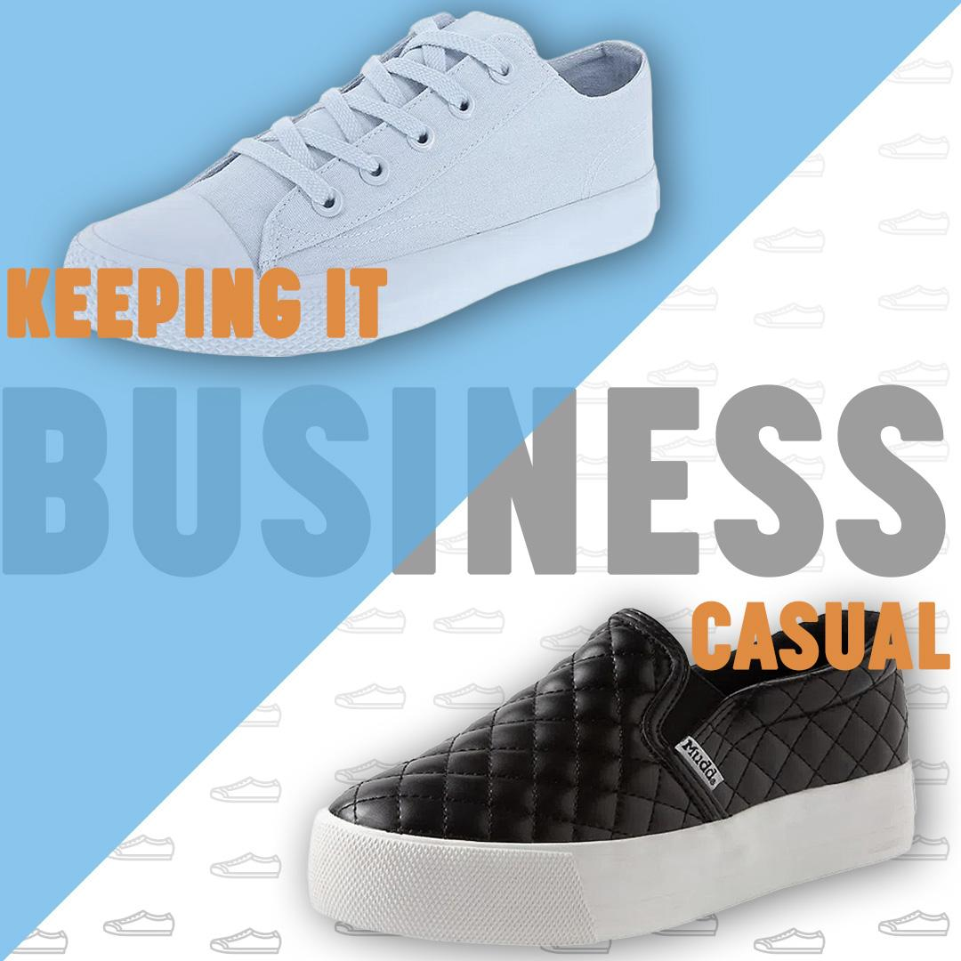
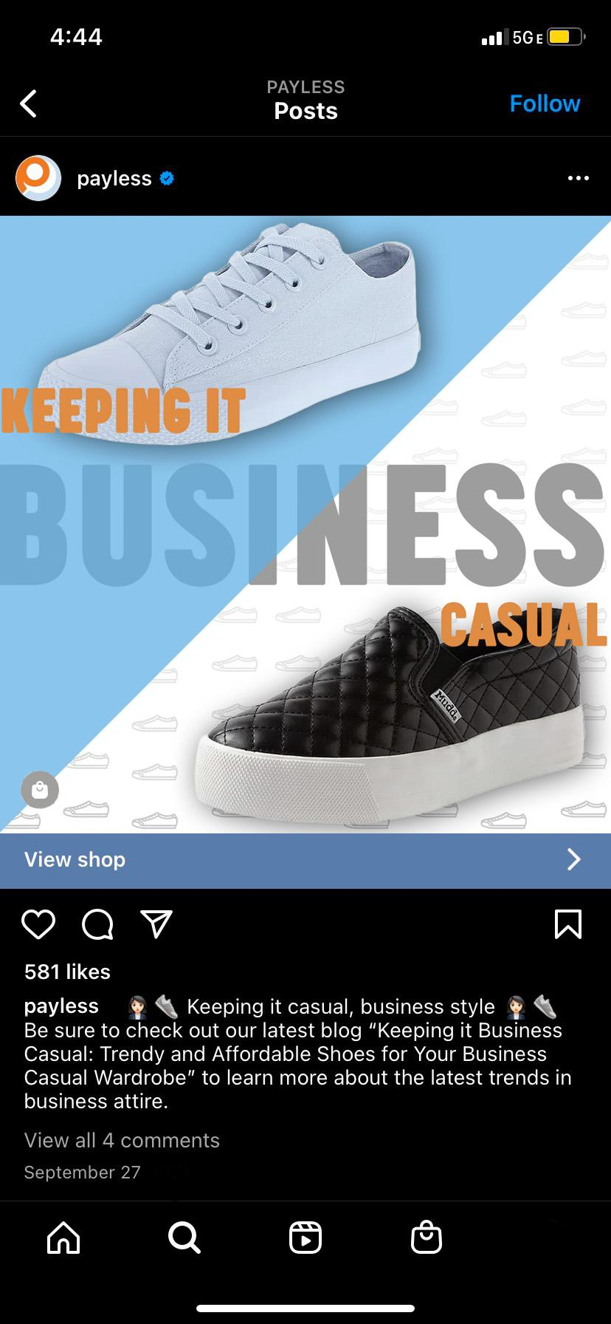

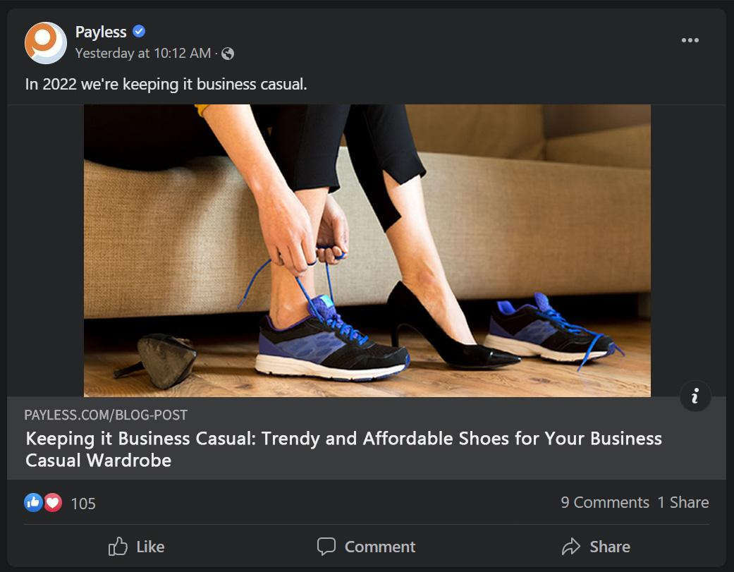
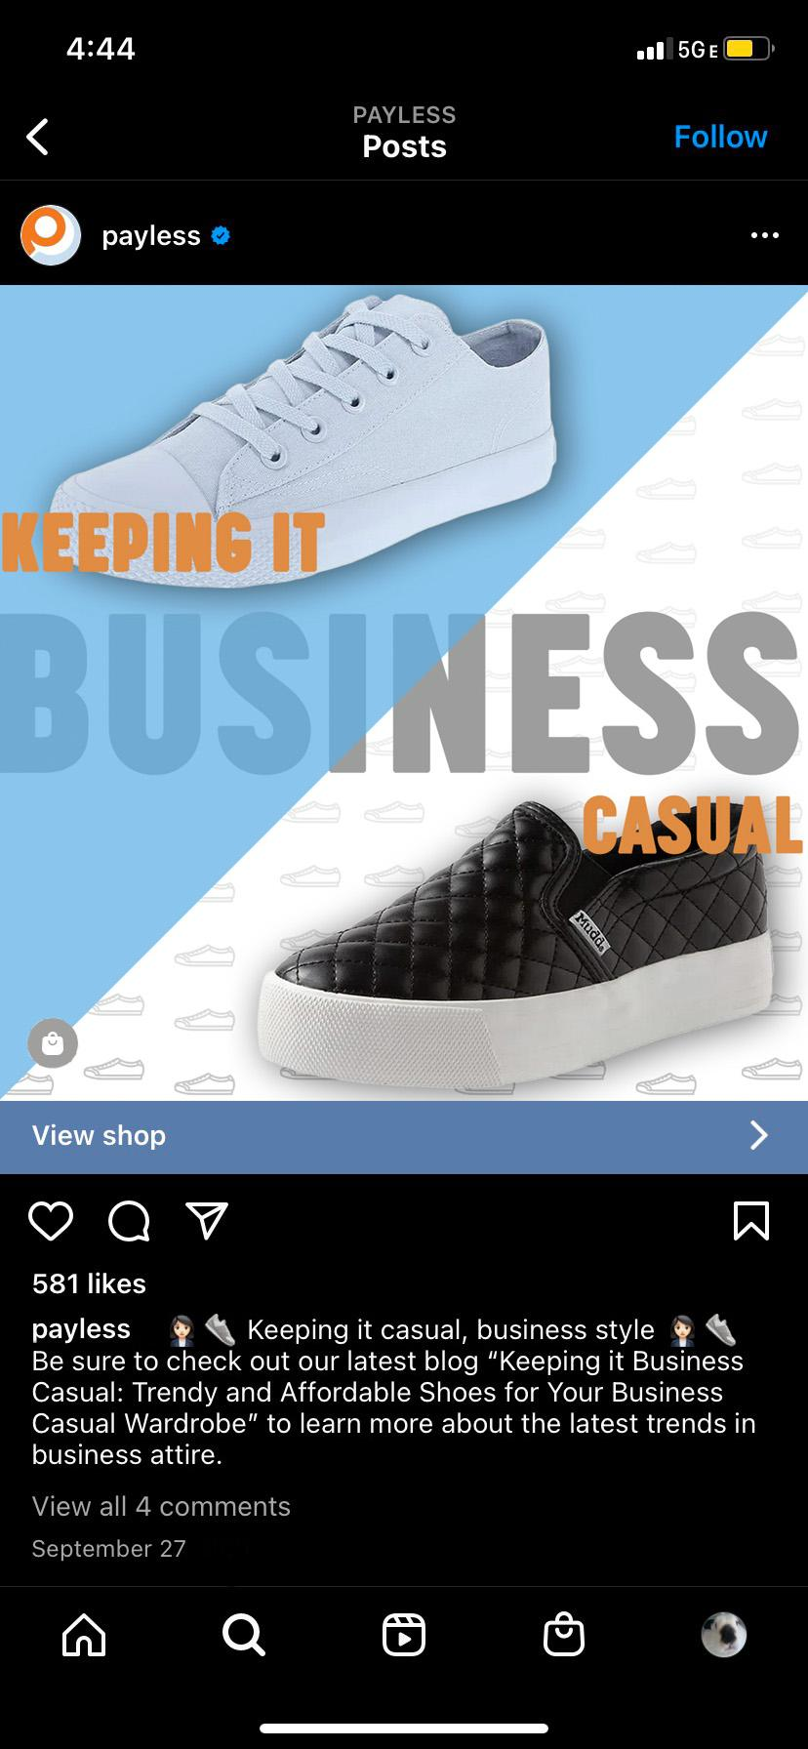
Content: Blog- “Keeping it Business Casual: Trendy and Affordable Shoes for Your Business Casual Wardrobe”
Facebook Ad and Instagram Post
ATTRACT
WHAT?

Slide 7
Content: Blog- “Keeping it Business Casual: Trendy and Affordable Shoes for Your Business Casual Wardrobe”
Facebook Ad and Instagram Post
WHY?
Late September/early October→ Immediate need: Business casual attire
48% of consumers in surveyed countries around the world say they get inspiration for purchases online
  A blog post about business casual trends featuring Payless products will inspire consumers to buy them
Other need: Early and affordable holidays shopping options
Hook consumers in by satisfying their immediate needs and establishing trust/loyalty, then remind them of their other need, which is early affordable options for Christmas

Slide 8
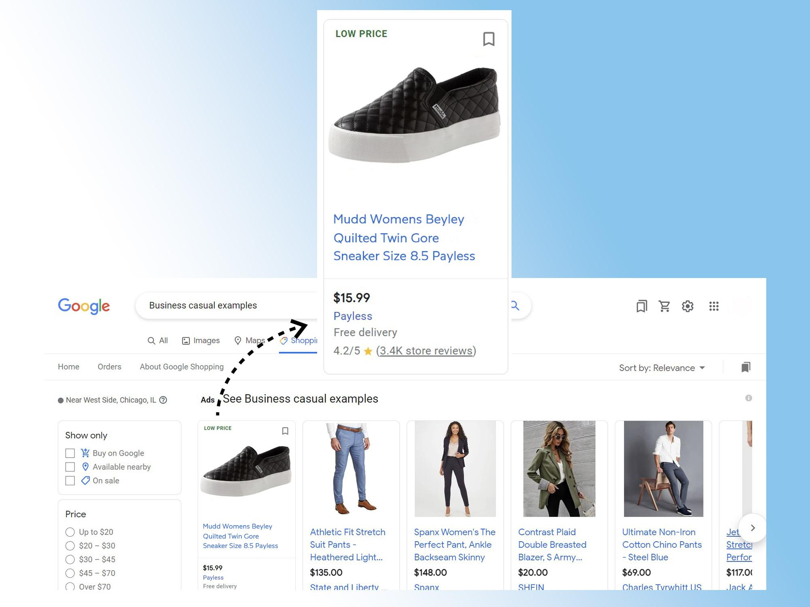
Content: Google Search Product Listing
ATTRACT
WHAT?
Google shopping product listing
  “Mudd Womens Beyley Quilted Twin Core Sneaker” - an example of a business casual shoe available at Payless
  If you show a consumer examples, they will be more likely to buy your brand
“Low price” on the top left
  Payless is the affordable option, attracts consumers and gains interest
“Free delivery”
  Entices consumers to order online
Notes:
Reference: https://www.thinkwithgoogle.com/marketing-strategies/search/business-casual-fashion-trends/

Slide 9
Content: Google Search Product Listing
WHY?
In the U.S. → 133% increase in searches for “business casual examples” and 143% increase in searches for “smart casual dress code”
Product listings at the top of Google searches with these keywords help consumers understand what business casual looks like, making the brand with the product listing appear to be on trend and credible, leading to more purchases
Notes:
Reference: https://www.thinkwithgoogle.com/marketing-strategies/search/business-casual-fashion-trends/

Slide 10
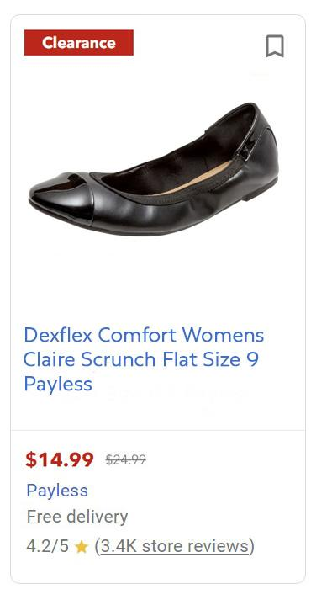

Content: Google Search Product Linked to the Payless Website
WHAT?
“Clearance” top left
  Makes it clear there is a sale on the item
Google search (all)
  Product image of “Dexflex Comfort Womens Claire Scrunch Flat”
    Keyword: Comfort
    If you show an example of what consumers are searching for, they are more likely to buy it
Show the price discount (cross out original price)
  Emphasizes that the consumer is getting a good deal on the product (higher quality, lower price)
“Free delivery”
  Entice the consumer to make an online purchase
ATTRACT
Notes:
Reference: https://www.thinkwithgoogle.com/marketing-strategies/search/business-casual-fashion-trends/

Slide 11
Content: Google Search Product Linked to the Payless Website
WHY?
Searches for comfortable attire like loafers and oversized garments are on the rise
  Product listings and descriptions need to match these search trends for the brand to show up and gain consumer interest
Adding information like “free delivery”, “low price”, and a product image to a Google search result can increase click-through rates, conversions, and purchases
Notes:
Reference: https://www.thinkwithgoogle.com/marketing-strategies/search/business-casual-fashion-trends/

Slide 12
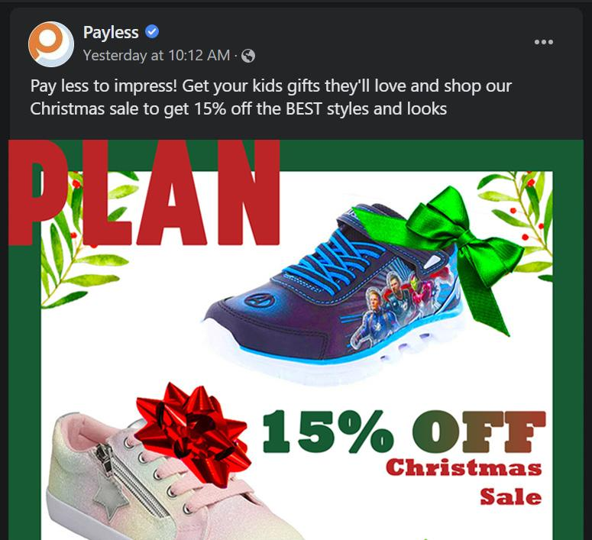
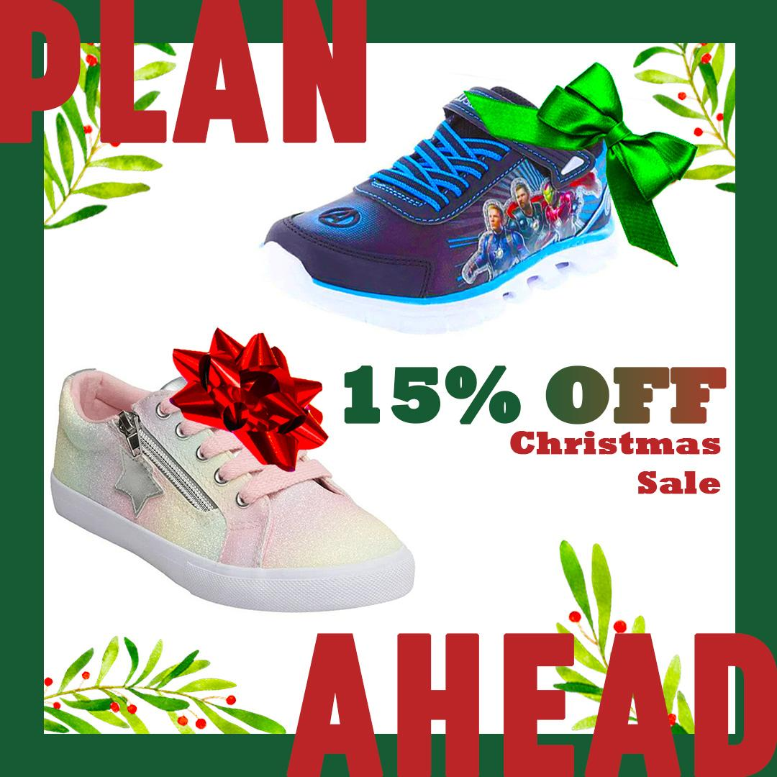
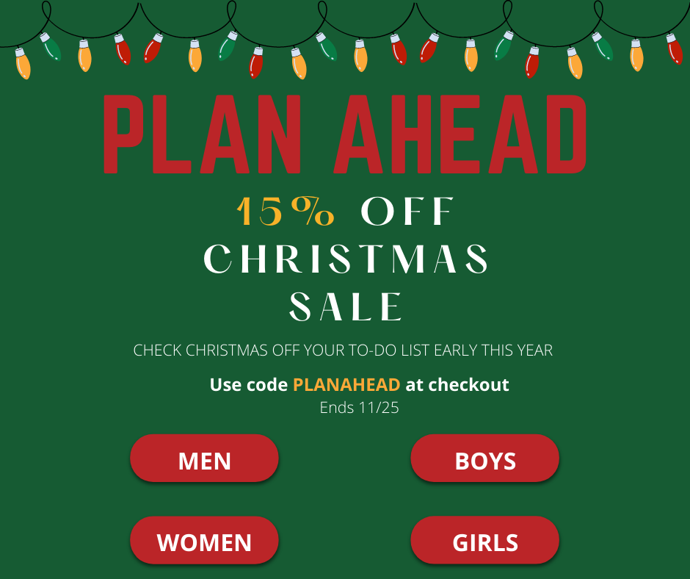
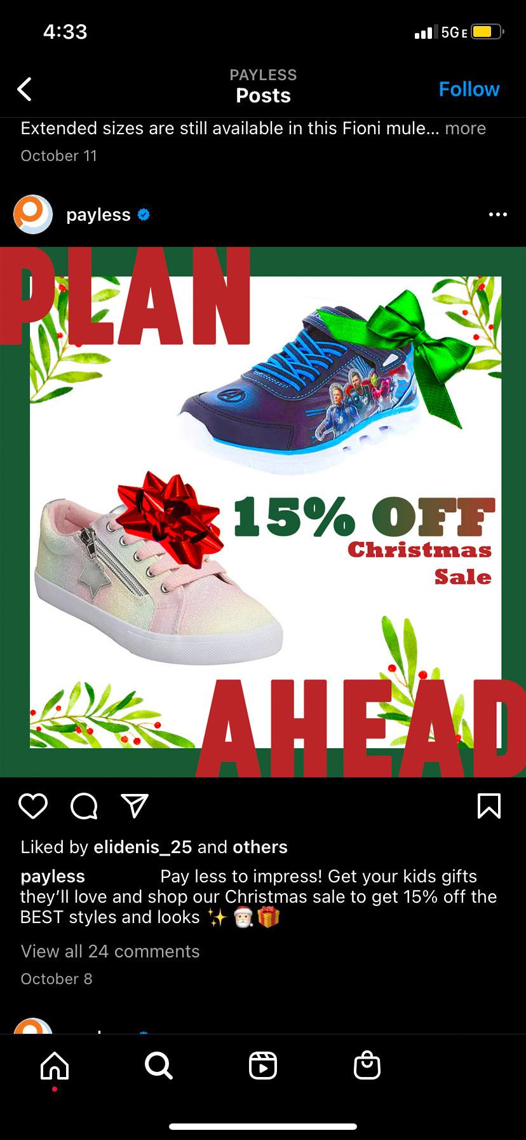
Content: Christmas Sale Website Header Ad and FB/Instagram Post
WHAT?
CONVERT

Slide 13
Content: PLAN AHEAD: Christmas Sale Website Header Ad and FB/Instagram Post
WHY?
We want to maximize the chances that our PLAN AHEAD: Christmas Sale reaches our target consumer- launching the campaign on our Website, Facebook, and Instagram
Between June and August, global online searches for “how many days until Christmas” grew by more than 60% year-over-year
  Shoppers are looking for Christmas gifts earlier in advance– even sooner than Black Friday
We want to launch our campaign in early October while consumers are searching for business casual attire
  We are reminding consumers that they need to start their Christmas shopping early
Our consumer is primarily on Facebook- we want to place our ads where our consumers can see it
  Facebook is the most popular social media network for men and women ages 35-44
  49% of Americans say they visit the platform several times a day
Notes:
Reference: https://www.thinkwithgoogle.com/consumer-insights/consumer-trends/shopping-trends-and-behaviors/
https://blog.hootsuite.com/facebook-demographics/

Slide 14

Content: Youtube Video Ad
WHAT?
“It’s a avocadooo…thanks” meme
  Audio and text
  Our target consumer is afraid of getting bad gifts for her kids
  Our consumer doesn’t want to wait last minute
Holiday audio in the background
  Brings Christmas spirit
Video clip of a Christmas to-do list
  Our target consumer is a planner; they like to stay ahead of the game
Background Christmas video with the Christmas sale promo overlaying it
  Helps the sale stand out
  Messaging reassures consumers they are making the right decision for their kids by shopping at Payless
A clip of a mother and her child opening gifts together
  Help the consumer envision a happy ending if they shop at Payless
  The mother figure matches our target consumer: single mother, around 42 years old
CONVERT
Notes:
Reference: https://www.thinkwithgoogle.com/consumer-insights/consumer-trends/shopping-trends-and-behaviors/

Slide 15
Content: Youtube Video Ad
WHY?
87% of people surveyed in the U.S. say they feel they get the highest-quality information about products when browsing on YouTube
A YouTube ad on a Payless product review video will reaffirm the consumer’s decision to shop at Payless and redirect the shopper back to the website to finalize the purchase
“It’s a avodadoooo, thankssss” viral vine
  Phrase people use when they receive a gift that they don’t like– it is funny and relatable
  Fear→ waiting last minute + low budgets = bad and unwanted gifts
  In 2015 the vine had over 48 million loops/views – potential to allow the ad to go viral by resurfacing the meme
We want the ad to feel personal and relatable to show that we understand our consumer and are empathetic to their needs
  Creates customer appreciation, driving customer loyalty and sales
Notes:
Reference: https://www.thinkwithgoogle.com/consumer-insights/consumer-trends/shopping-trends-and-behaviors/

Slide 16
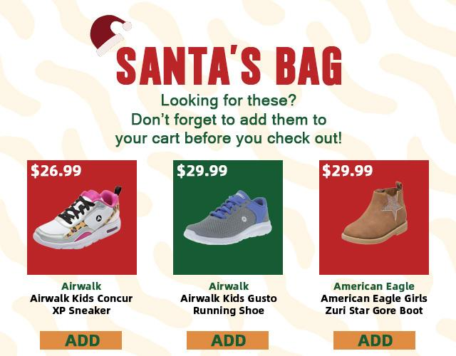
Content: Algorithm Displays Products on the Website Home Page that were Previously Viewed by the Consumer
WHAT?
CLOSE
Notes:
Reference: https://www.thinkwithgoogle.com/consumer-insights/consumer-trends/shopping-trends-and-behaviors/

Slide 17
Content: Algorithm Displays Products on the Website Home Page that were Previously Viewed by the Consumer
WHY?
Reminding customers about the last items they viewed will make the shopping experience easier and more convenient for them, allowing them to finish what they started, leading to an increase in sales
Notes:
Reference: https://yithemes.com/blog/tutorials/how-to-use-the-recently-viewed-products-to-increase-sales-on-your-woocommerce-store/

Slide 18
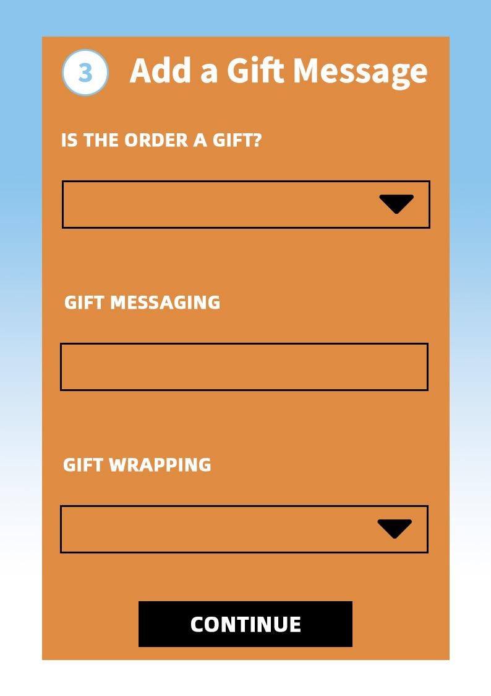
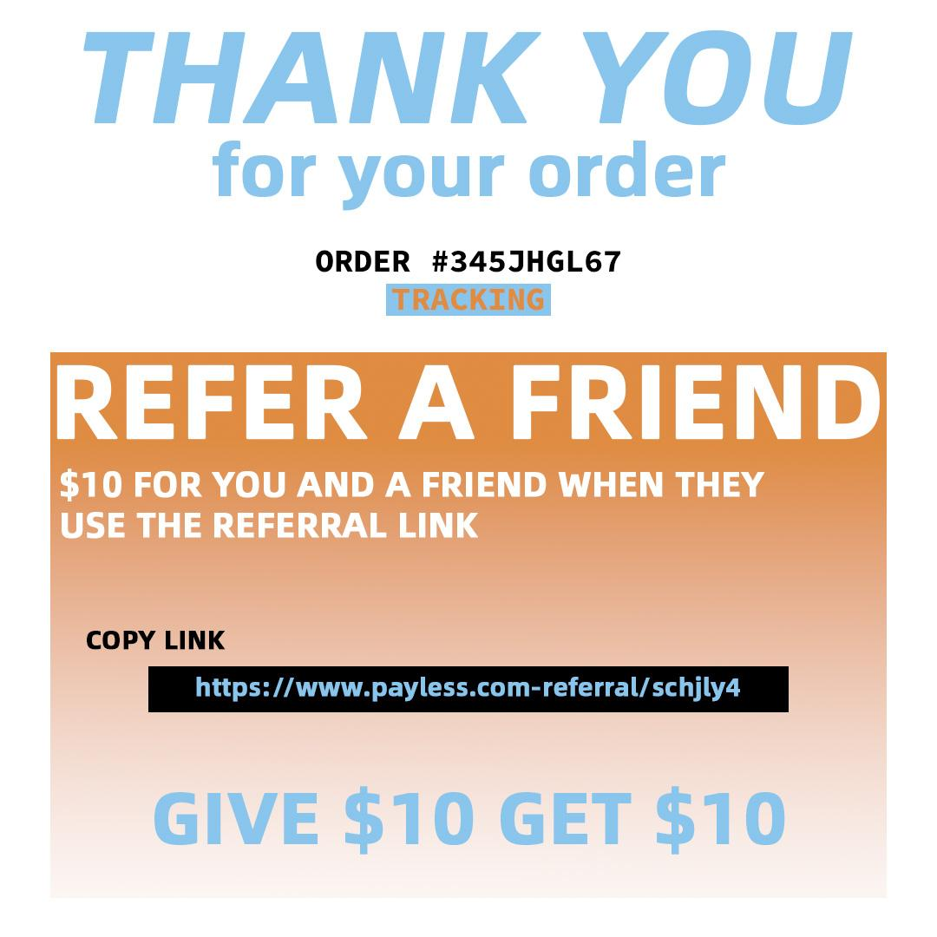
Content: Gift Messaging/Wrapping Checkout Menu and Refer a Friend GIVE $10 GET $10
WHAT?
Offer three gift wrapping options in the drop-down menu:
  Silver snowflakes
  Red and white stripes
  Candy canes
Email referral: $10 for you and your friend when they use the referral link
Thank you!
Order number and tracking
WHY?
Our target consumer has a busy schedule, offering to wrap and customize gifts helps to make their lives easier
  Creates a strong relationship between the consumer and the brand
  Customer will continue shopping with us in the future
Word-of-mouth, a $10 referral will allow Shannon to share our brand and her experiences to others, increasing our customer base
CLOSE
Notes:
Reference: https://yithemes.com/blog/tutorials/how-to-use-the-recently-viewed-products-to-increase-sales-on-your-woocommerce-store/

Slide 19
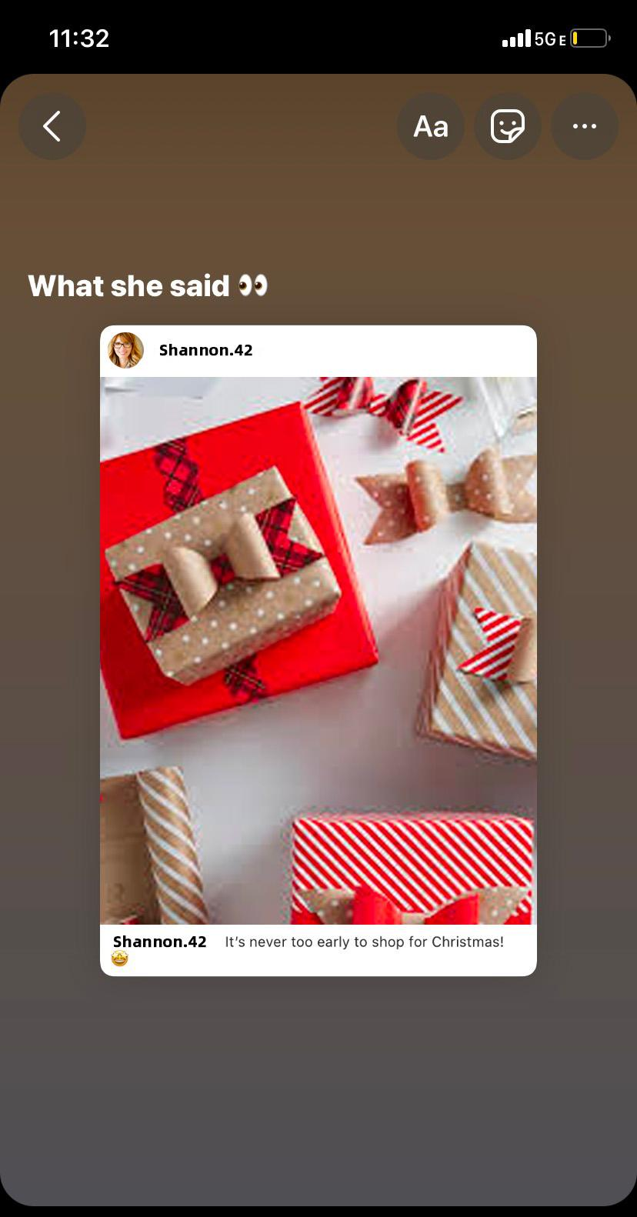
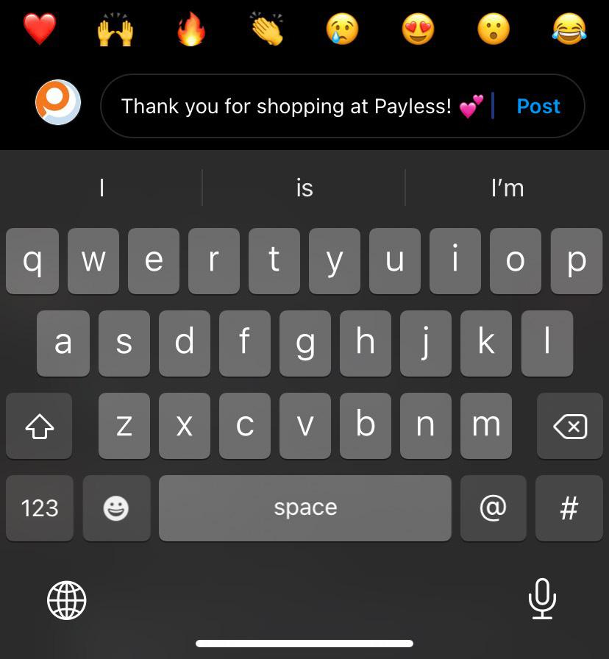
Content: Repost customer photo on Facebook Story
WHAT?
Comment on Shannon’s post “Thank you for shopping at Payless!”
Repost Shannon’s picture on Payless’s story
Say “What she said” referring to Shannon’s caption “It’s never too early to shop for Christmas”
WHY?
Shows gratitude, creates customer loyalty
Builds a strong relationship and bond
DELIGHT
Notes:
Reference: https://yithemes.com/blog/tutorials/how-to-use-the-recently-viewed-products-to-increase-sales-on-your-woocommerce-store/

