Slide 1
Assignment 5: Tableau Team 3
Kyra, Celeste, Alani, and Dhanvii

Slide 2

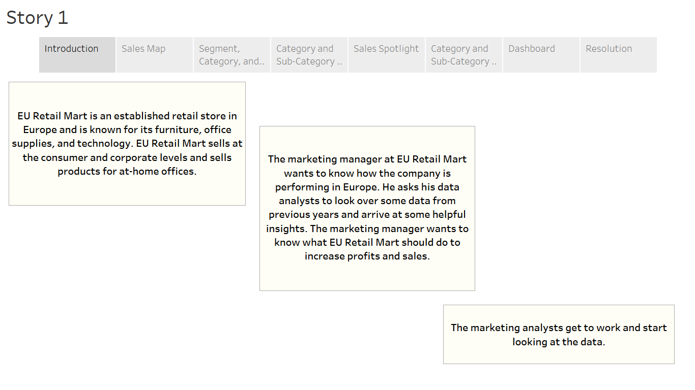

Slide 3

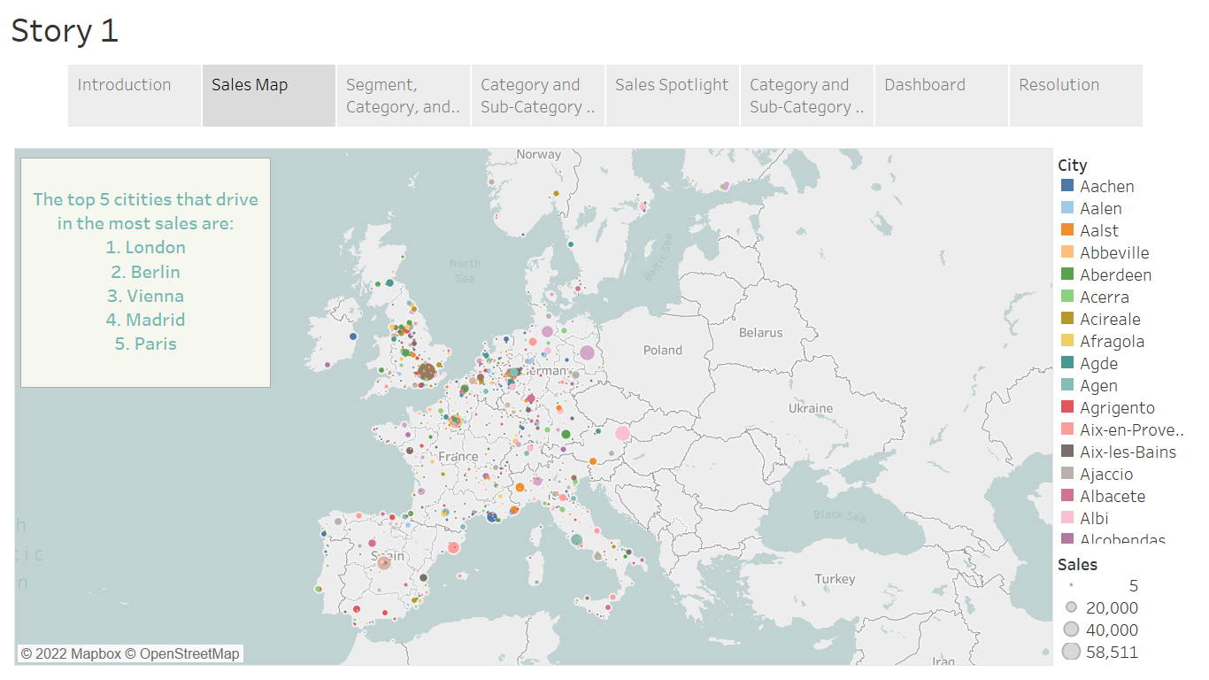

Slide 4
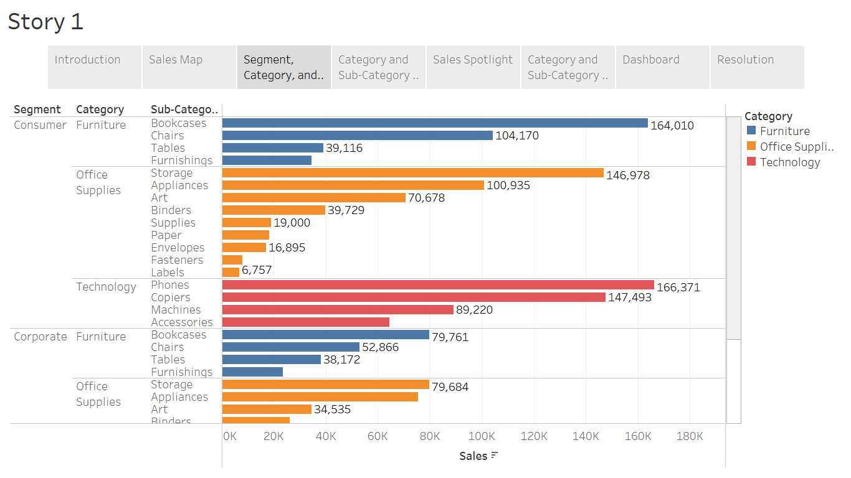
In the Office Supplies Category, sales tend to be lower for binders, supplies, paper, envelopes, fasteners, and labels
The top two segments are Consumer and Corporate with respect to sales
The top five sub-categories are Bookcases, Phones, Copiers, Chairs, and Appliances with respect to sales

Slide 5
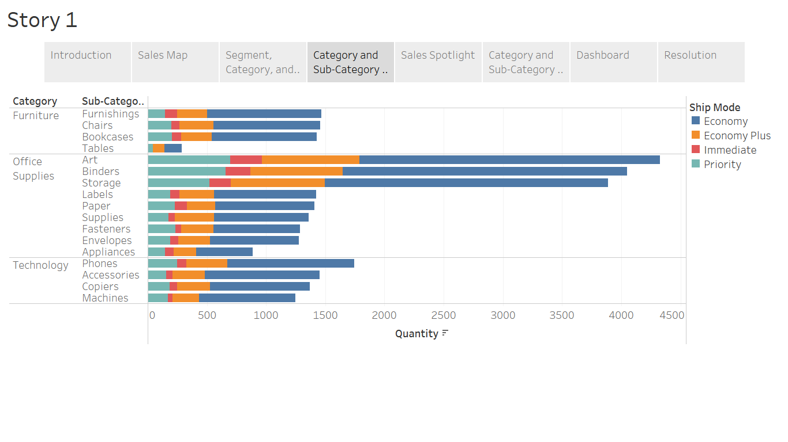
EU Retail Mart chooses Economy shipping for larger quantity orders and priority shipping for smaller quantity orders
In terms of quantity, Economy is the most heavily used ship mode across all Categories and Sub-Categories, with economy plus second

Slide 6
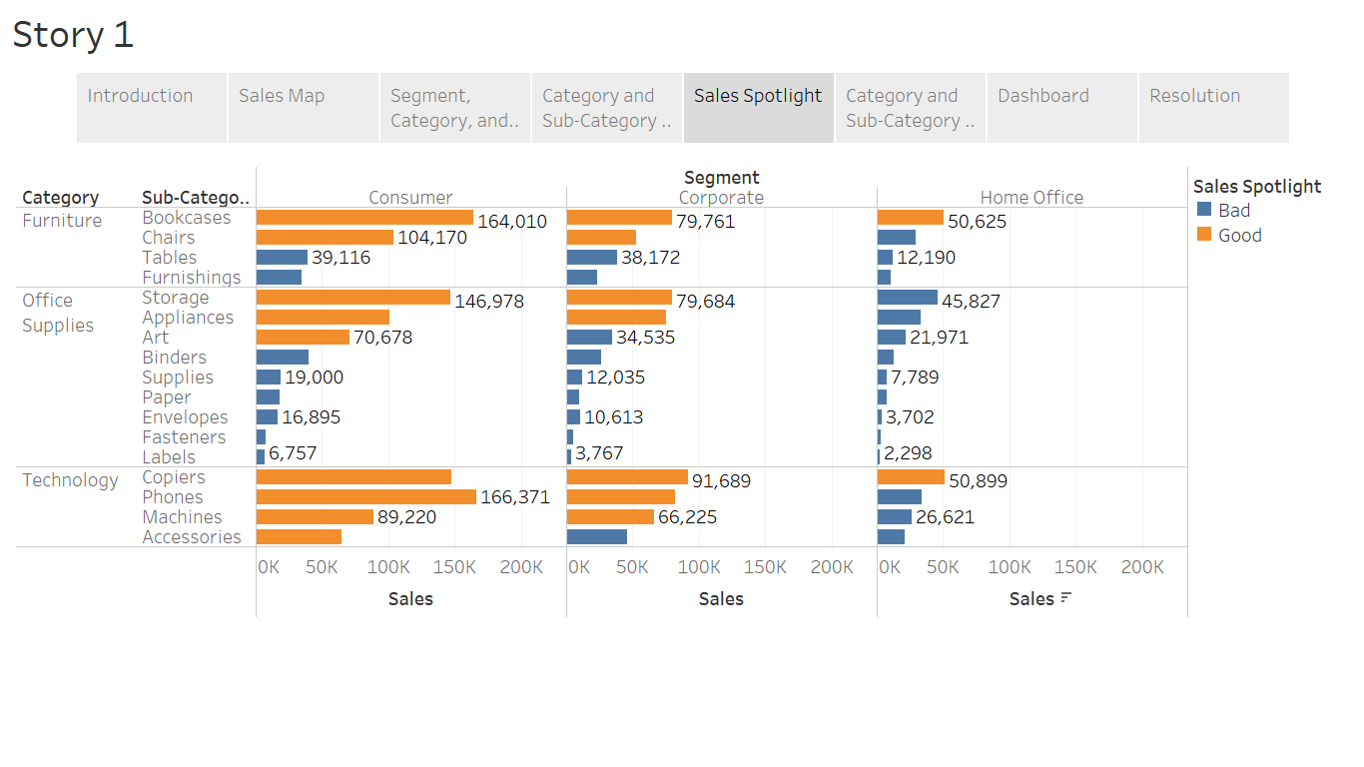
The sales spotlight highlights which categories are generating more than $50,000 in sales
Office Supplies Category: Binders, Supplies, Paper, Envelopes, Fasteners, and Labels do not reach or exceed $50,000 in sales across all three segments
Technology Category: the only Sub-Categories that do not meet the $50,000 benchmark are Accessories in the Corporate segment and Phones, Machines, and Accessories in the Home Office Segment
Furniture Category: Tables and Furnishings across all three Segments do not reach or exceed $50,000 in sales
The only two Sub-Categories that exceed $50,000 in sales in the Home Office segment is Bookcases and Copiers

Slide 7
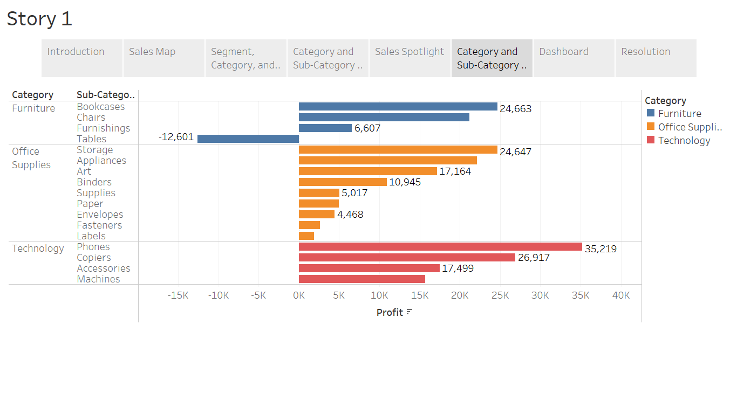
The top three Sub-Categories with respect to profit are Phones, Bookcases, and Storage
In the Furniture Category, the only Sub-Category that generated negative profits was Tables
In the Office Supplies Category, profits are especially low for Supplies, Paper, Envelopes, Fasteners, and Labels
Products in the Technology Category generate the most profits

Slide 8
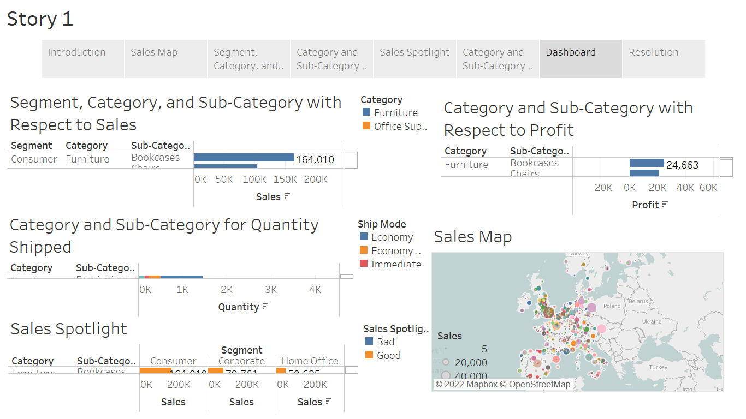

Slide 9

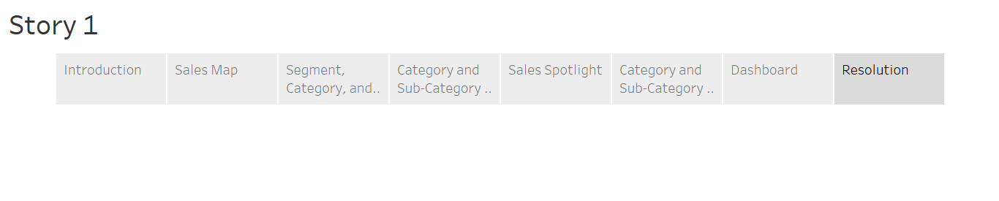
The marketing analysts are done going through all the data and have created insights that can be transformed into solutions. Here is what the marketing analysts suggested to their marketing manager at EU Retail Mart:
EU Retail Mart should open more stores in London, Berlin, Vienna, Madrid, and Paris because those are locations that bring in a lot of sales.
EU Retail Mart should consider condensing their Office Supplies product line because most of those products do not bring in a lot of sales or profits; more specifically, EU Retail Mart should only include Storage, Appliances, Art, and Binders Sub-Categories.
Ship products in larger bulks for economy shipping, which will help lower costs.
Focus on Corporate and Consumer Segments; Home Office segment does not bring in a lot of sales for EU Retail Mart.
Increase investment in the Technology Category- it generates the most amount of sales and profits. EU Retail Mart can expand product offerings in this Category or offer technology services.
Focus on Bookcases, Phones, Copiers, Chairs, and Appliances. Invest in these products by offering different versions, colors, or styles. These products bring in the most profits and sales.
Get rid of Tables completely- they bring in negative profitability and do not help the business.

